Slide 1
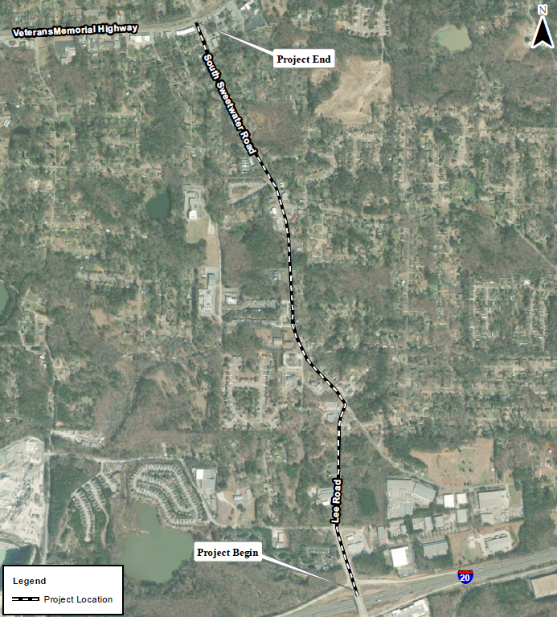
Why are we here?
To provide comments on the proposed project: Phase I Widening of County Road (CR) 817/Lee Road and CR 818/South Sweetwater Road
PI No. 0013563
We need your input!

Slide 2
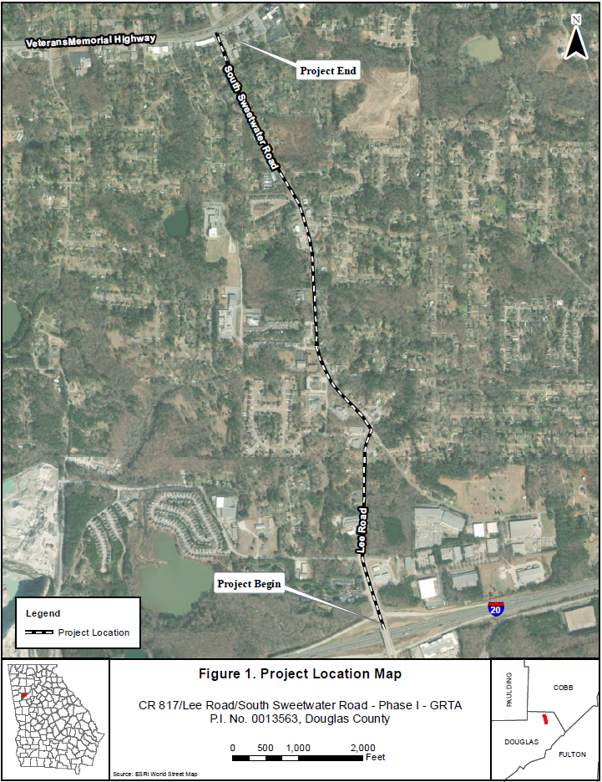

Slide 3

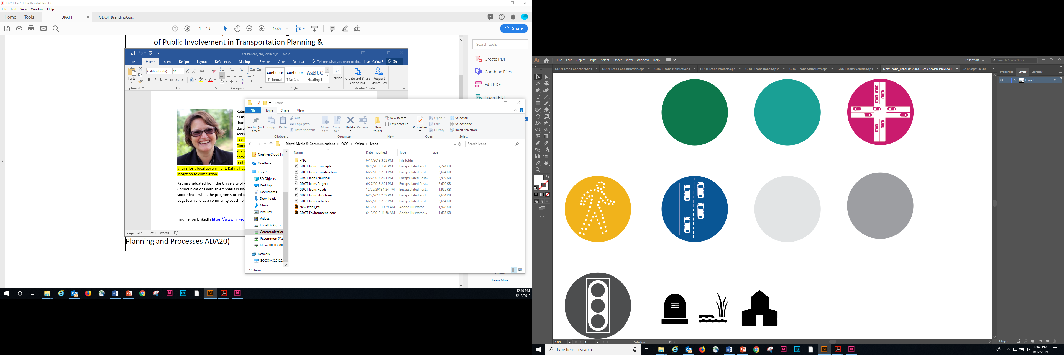
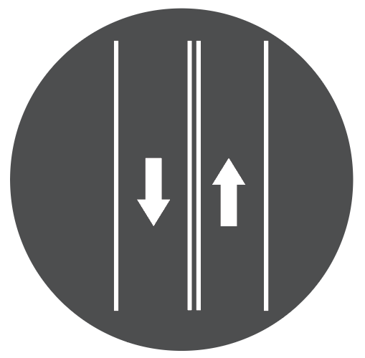
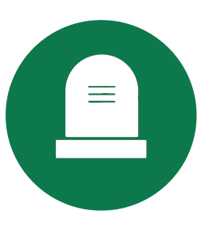
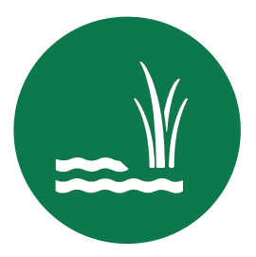
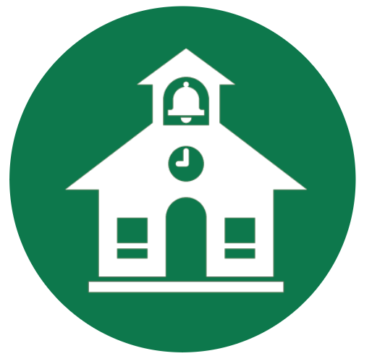
Project Goals
Mobility
Operations
Safety
Minimizing impacts to properties and
environmentally sensitive areas
Provide additional capacity to improve traffic flow and vehicular delays
Reduce volume of crashes
Conduct environmental analysis to determine avoidance and minimization to the physical and social environment to the extend feasible
Improved connectivity between activity centers in the eastern portion of the County and alternate routes for traffic around the City of Douglasville, which falls in line with the Douglas County Comprehensive Plan and Comprehensive Transportation Plan.

Slide 4
Existing Conditions | Proposed Improvements
From Vulcan Drive to Skyview Drive: four 11-ft travel lanes (two in each direction), 20-ft raised median, 2.5-ft curb & gutter, a 2-ft grass beauty strip, a 5-ft sidewalk along one shoulder and an 8-ft trail along the other.
From Skyview Drive to US 78/Veterans Memorial Parkway: two 11-foot travel lanes (one in each direction) with a 14-foot two-way-left-turn lane, 2.5-ft curb & gutter, a 2-ft grass beauty strip, a 5-ft sidewalk along one shoulder and an 8-ft multi-use trail along the other.
Two 12-ft travel lanes (one in each direction).
Rural/variable width grass shoulders and intermittent sidewalks.
No raised medians to separate opposite moving traffic except a small portion of CR 817/Lee Road starting south from Vulcan Drive.

Slide 5
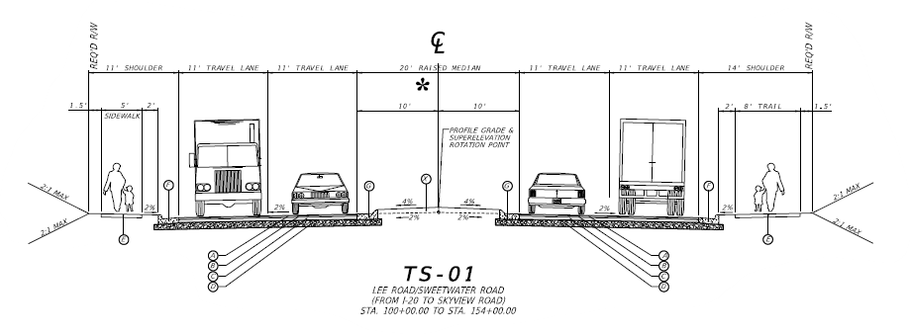
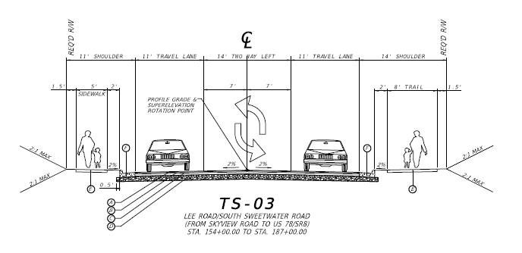
Proposed Improvements: Typical Sections

Slide 6


Existing Conditions to be Addressed
From 2019 to 2021, crash rates and injury crash rates for this section of corridor were more than double the statewide average for a similar functional classification of road (Minor Arterial, Urbanized).
2023 Average Annual Daily Traffic (AADT) along the corridor = 13,375 vehicles daily
Currently operates at Level of Service (LOS)* C in the morning and D in the evening.
Future (2051) traffic volumes are projected to be 18,675 vehicles daily operating at LOS D in the morning E in the evening.
*LOS refers to the condition or performance of a roadway, with a score of “A” representing a highly performing roadway and an “F” representing a poorly performing roadway.

Slide 7
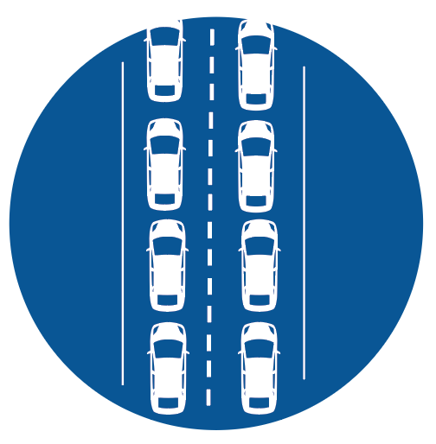



Without this Project
Continued poor traffic flow and delays due to increasing vehicular congestion.
Traffic congestion would not be addressed, creating further delays for commercial and industrial businesses as well as residences along the corridor.
Volume of vehicular crashes would not be improved.
Would not support the Douglas County Comprehensive Plan and Comprehensive Transportation Plan of improving connectivity between activity centers in the eastern portion of the County or providing alternate routes for traffic around the City of Douglasville.

