Slide 1

DOUGLAS COUNTY BOARD OF COMMISSIONERS 8700 HOSPITAL DRIVE
DOUGLASVILLE, GEORGIA 30134
LOCAL POSTAL
CUSTOMER

Slide 2
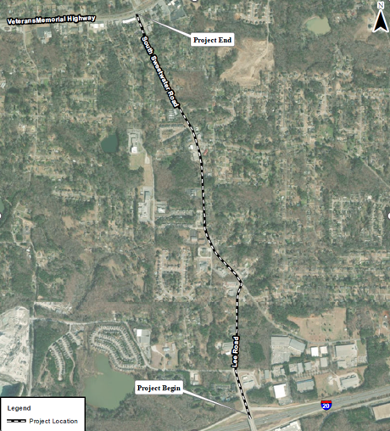



Collecting Feedback: Proposed Phase I widening of County Road (CR) 817/Lee Road and CR 818/South Sweetwater Road
Proposed Project (PI # 0013563): Douglas County proposes to widen CR 817/Lee Road and CR 818/South Sweetwater Road beginning at the intersection of CR 817/Lee Road and Vulcan Drive and extending north for approximately 1.4 miles to the intersection of CR 818/South Sweetwater Road and US 78/Veteran’s Memorial Highway. Douglas County is seeking feedback about the proposed project.
On Wednesday, January 29, 2025, Douglas County will hold a Public Information Open House meeting concerning the project.
Please join us at the Lithia Springs Senior Center, 7301 Groovers Lk Rd, Lithia Springs, GA 30122, from 4:00-7:00pm.
This meeting is informal, and the public is welcome to drop in anytime during this timeframe.
Comments will be accepted concerning this project after the Public Information Open House until Friday, February 28, 2025. Online comments may be submitted at: the county website placeholder. Written statements may be submitted to: Suleman Rana, 8700 Hospital Drive, Douglasville, GA 30134
The meeting site is accessible to persons with disabilities. Accommodations for people with disabilities can be arranged with advance notice by contacting the County Program Delivery Engineer in the following ways:
Questions, Concerns, and ADA Requests:
Suleman Rana
770-920-4924
srana@douglascountyga.gov

