Slide 1
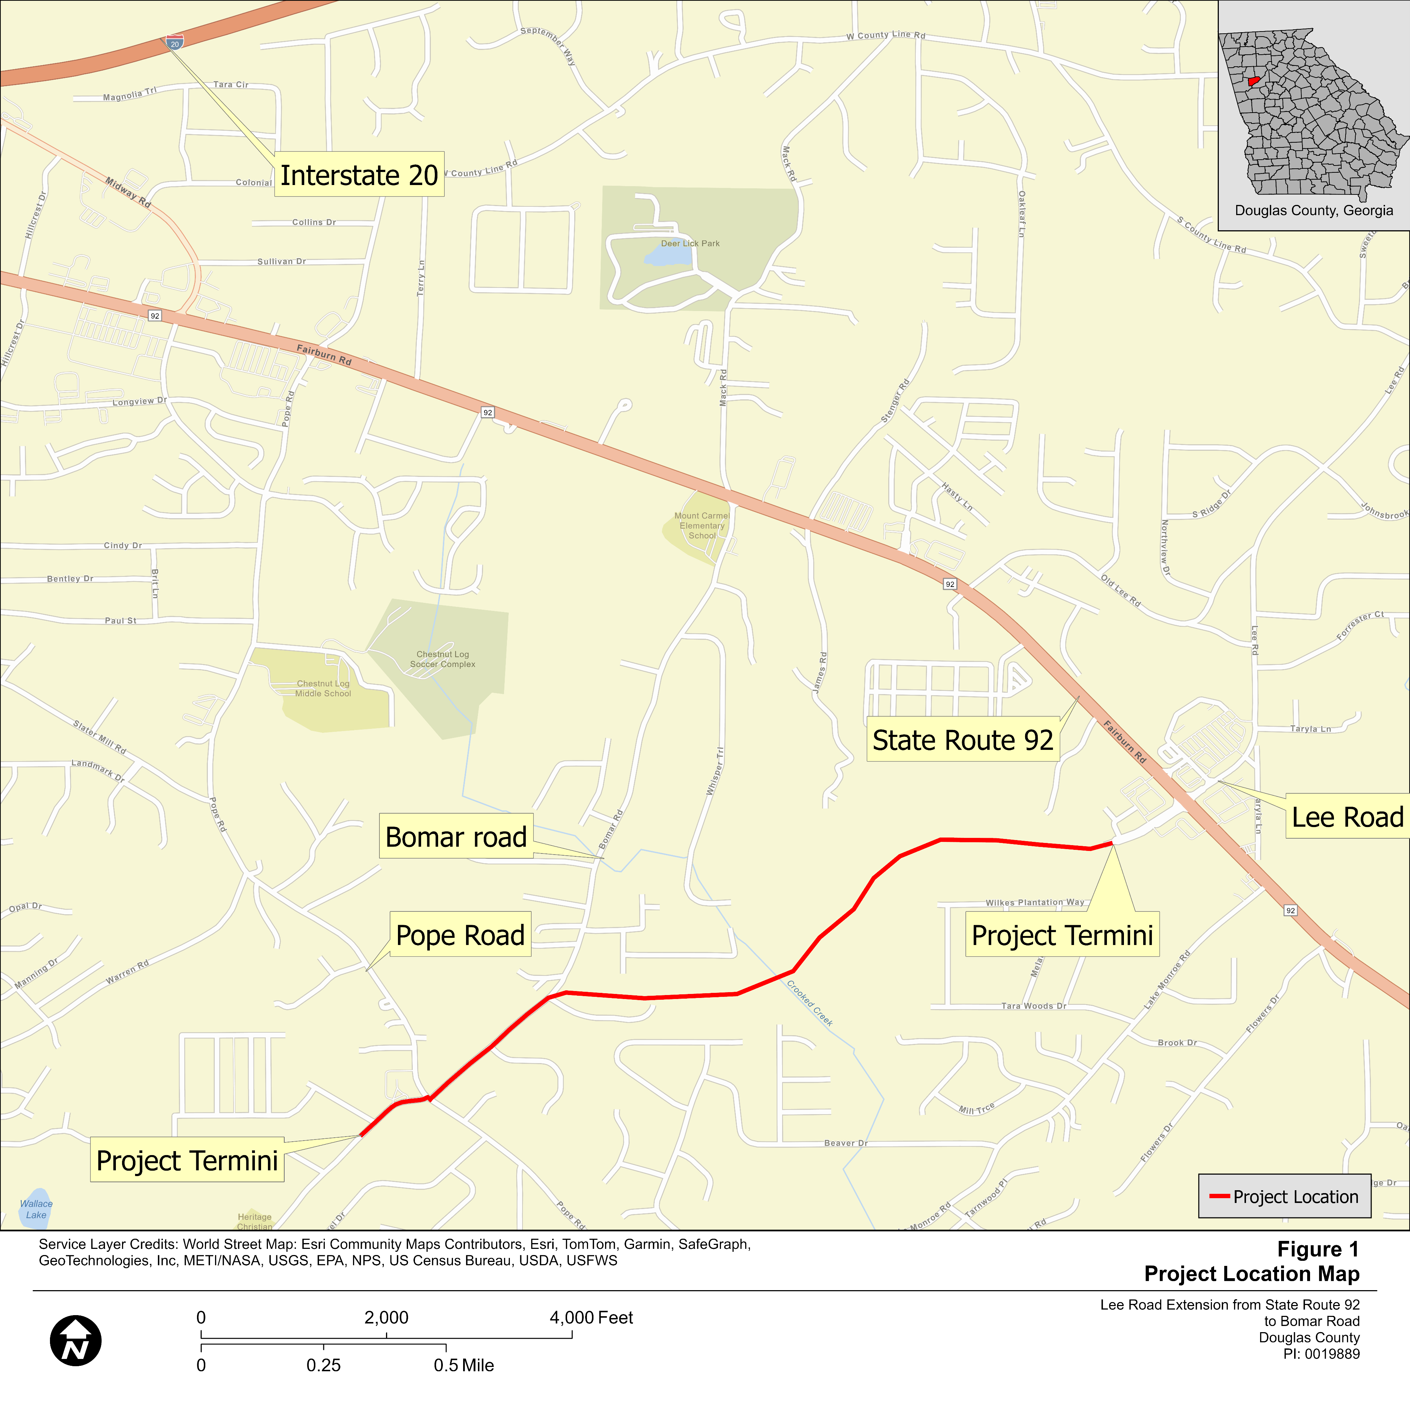
Why are we here?
To provide comments on the environmental document for the proposed: Widening Bomar Road from approximately 600 feet south of the intersection of Bomar Road at Pope Road. The widening would continue north along Bomar Road for 1,550 feet. From this point along Bomar Road, the project would continue at a new location to approximately 500 feet southwest of the State Route (SR) 92 at Lee Road intersection. The project length is 1.7 miles.
We need your input!

Slide 2
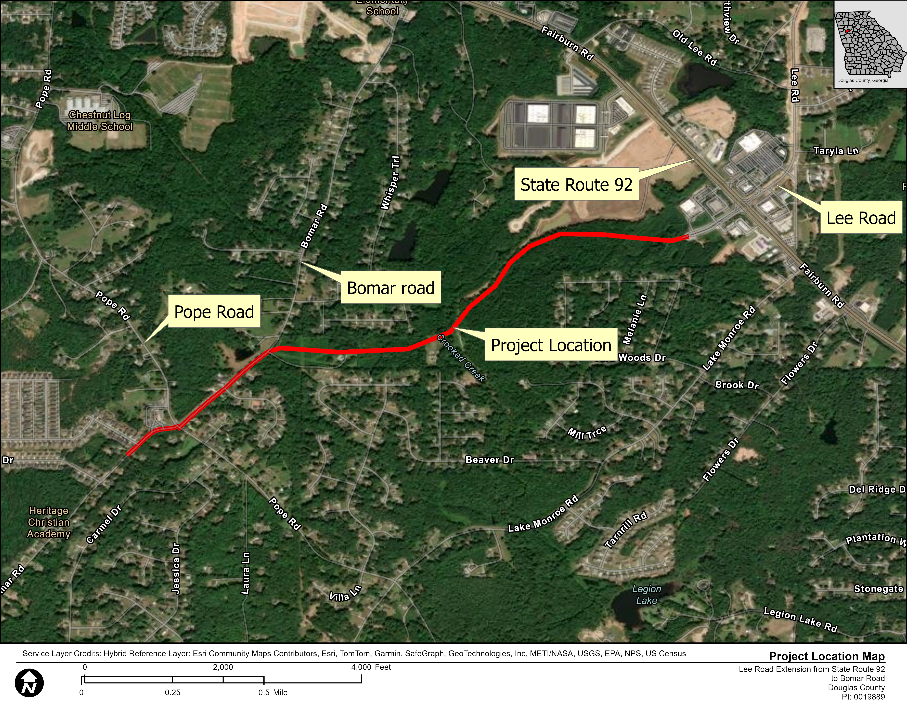

Slide 3
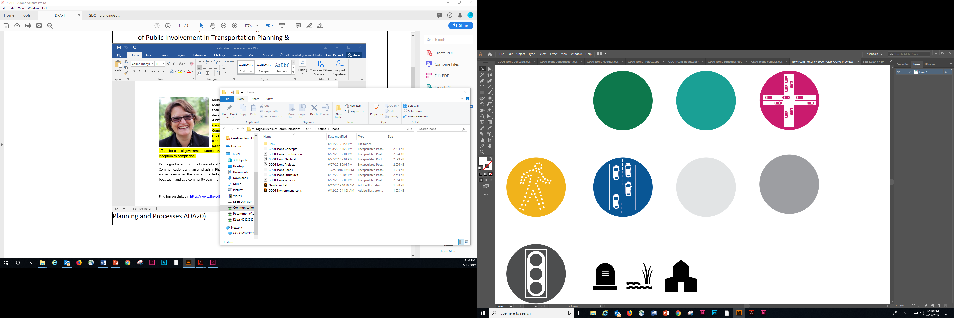
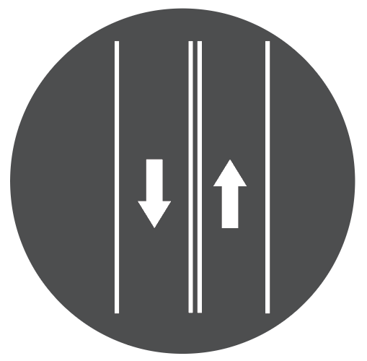
Project Need & Purpose
Project Need & Purpose
Mobility
Connectivity
Safety
Operations
Need:
Purpose:
Improve connectivity and access for commuters traveling within the central part of Douglas County
To improve connectivity by extending Lee Road to Bomar Road on a new location roadway, providing an important county-wide east-west connector

Slide 4
Secondary Benefits
Mobility
Safety
Operations
Congestion relief to SR 92 by diverting traffic flow to Lee Road and Bomar Road utilizing the new location
Operational and safety improvements along Bomar Road north of Pope Road and the Bomar at Pope Road intersection
Provide needed pedestrian infrastructure

Slide 5
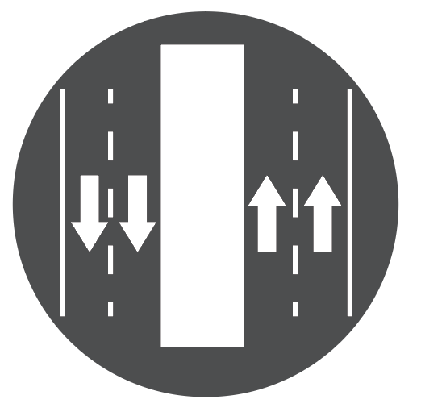



Existing Conditions
Proposed Conditions
Two rural 11-foot-wide lanes with narrow rural shoulders
No sidewalks
Bomar Road at Pope Road intersection is controlled by all-way-stop
The existing portion of Lee Road stops north of SR 92
Four 12-foot-wide travel lanes (two in each direction)
20-foot-wide raised median
Bomar Road at Pope Road intersection reconstructed as a roundabout
5-foot-wide sidewalks along western side
10-foot-wide shared-use path on the eastern side
Lee Road extended to Bomar Road along a new location south of SR 92

Slide 6
Proposed Improvements: Typical Sections

Slide 7
Proposed Improvements: Typical Sections

Slide 8
What Happens If the Project is Not Implemented?
Residential growth and future development are expected to cause an increase in the volume of traffic along SR 92 and surrounding roadways and increased congestion regardless of implementation of the proposed project.
Communities would not benefit from increased connectivity to I-20, decreased traffic congestion and travel times, and
The corridor would continue to lack opportunities for pedestrian access.

Slide 9
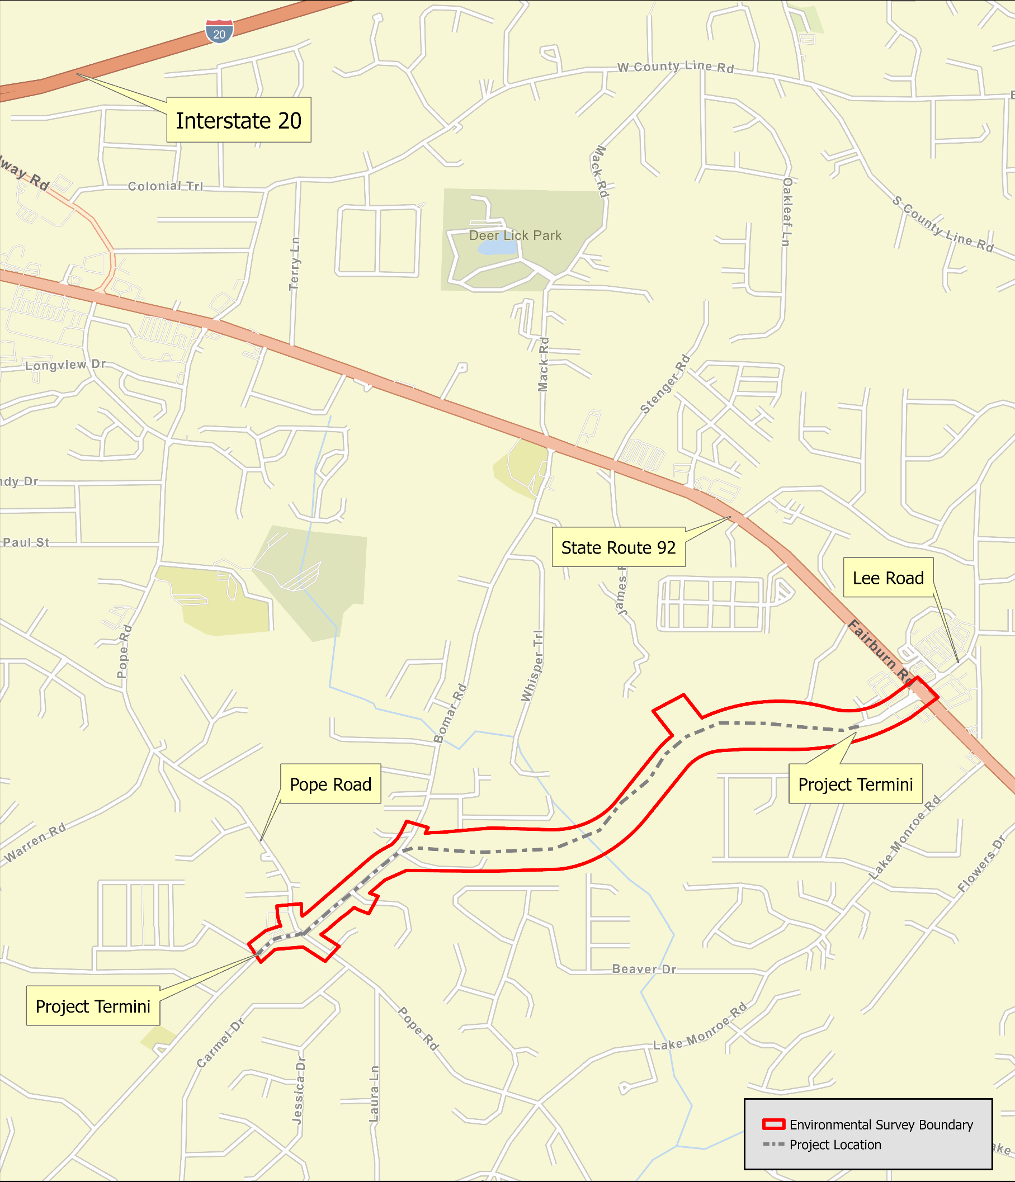
Summary of Environmental Findings
In compliance with the 1969 National Environmental Policy Act, the Georgia Department of Transportation has conducted an assessment of the social, economic and environmental effects for the proposed 1.7-mile project beginning approximately 600 feet south of the intersection of Bomar Road at Pope Road. The following slides gives a summary of the environmental document:

Slide 10
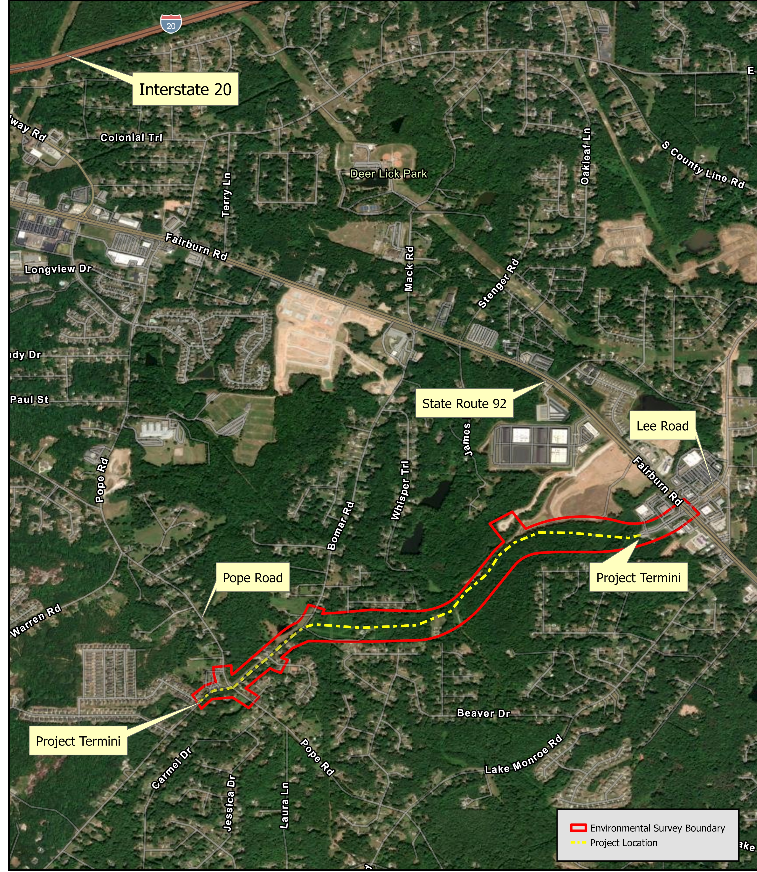
Environmental Findings: Community Impacts
No residences or businesses would be displaced by the proposed project.
10 parking spots (out of 114) at Believer’s Church would be removed
One of two southern parking lot entrances at Believer’s Church would be removed
Additional Right-Of-Way (ROW) information discussed later in the presentation

Slide 11
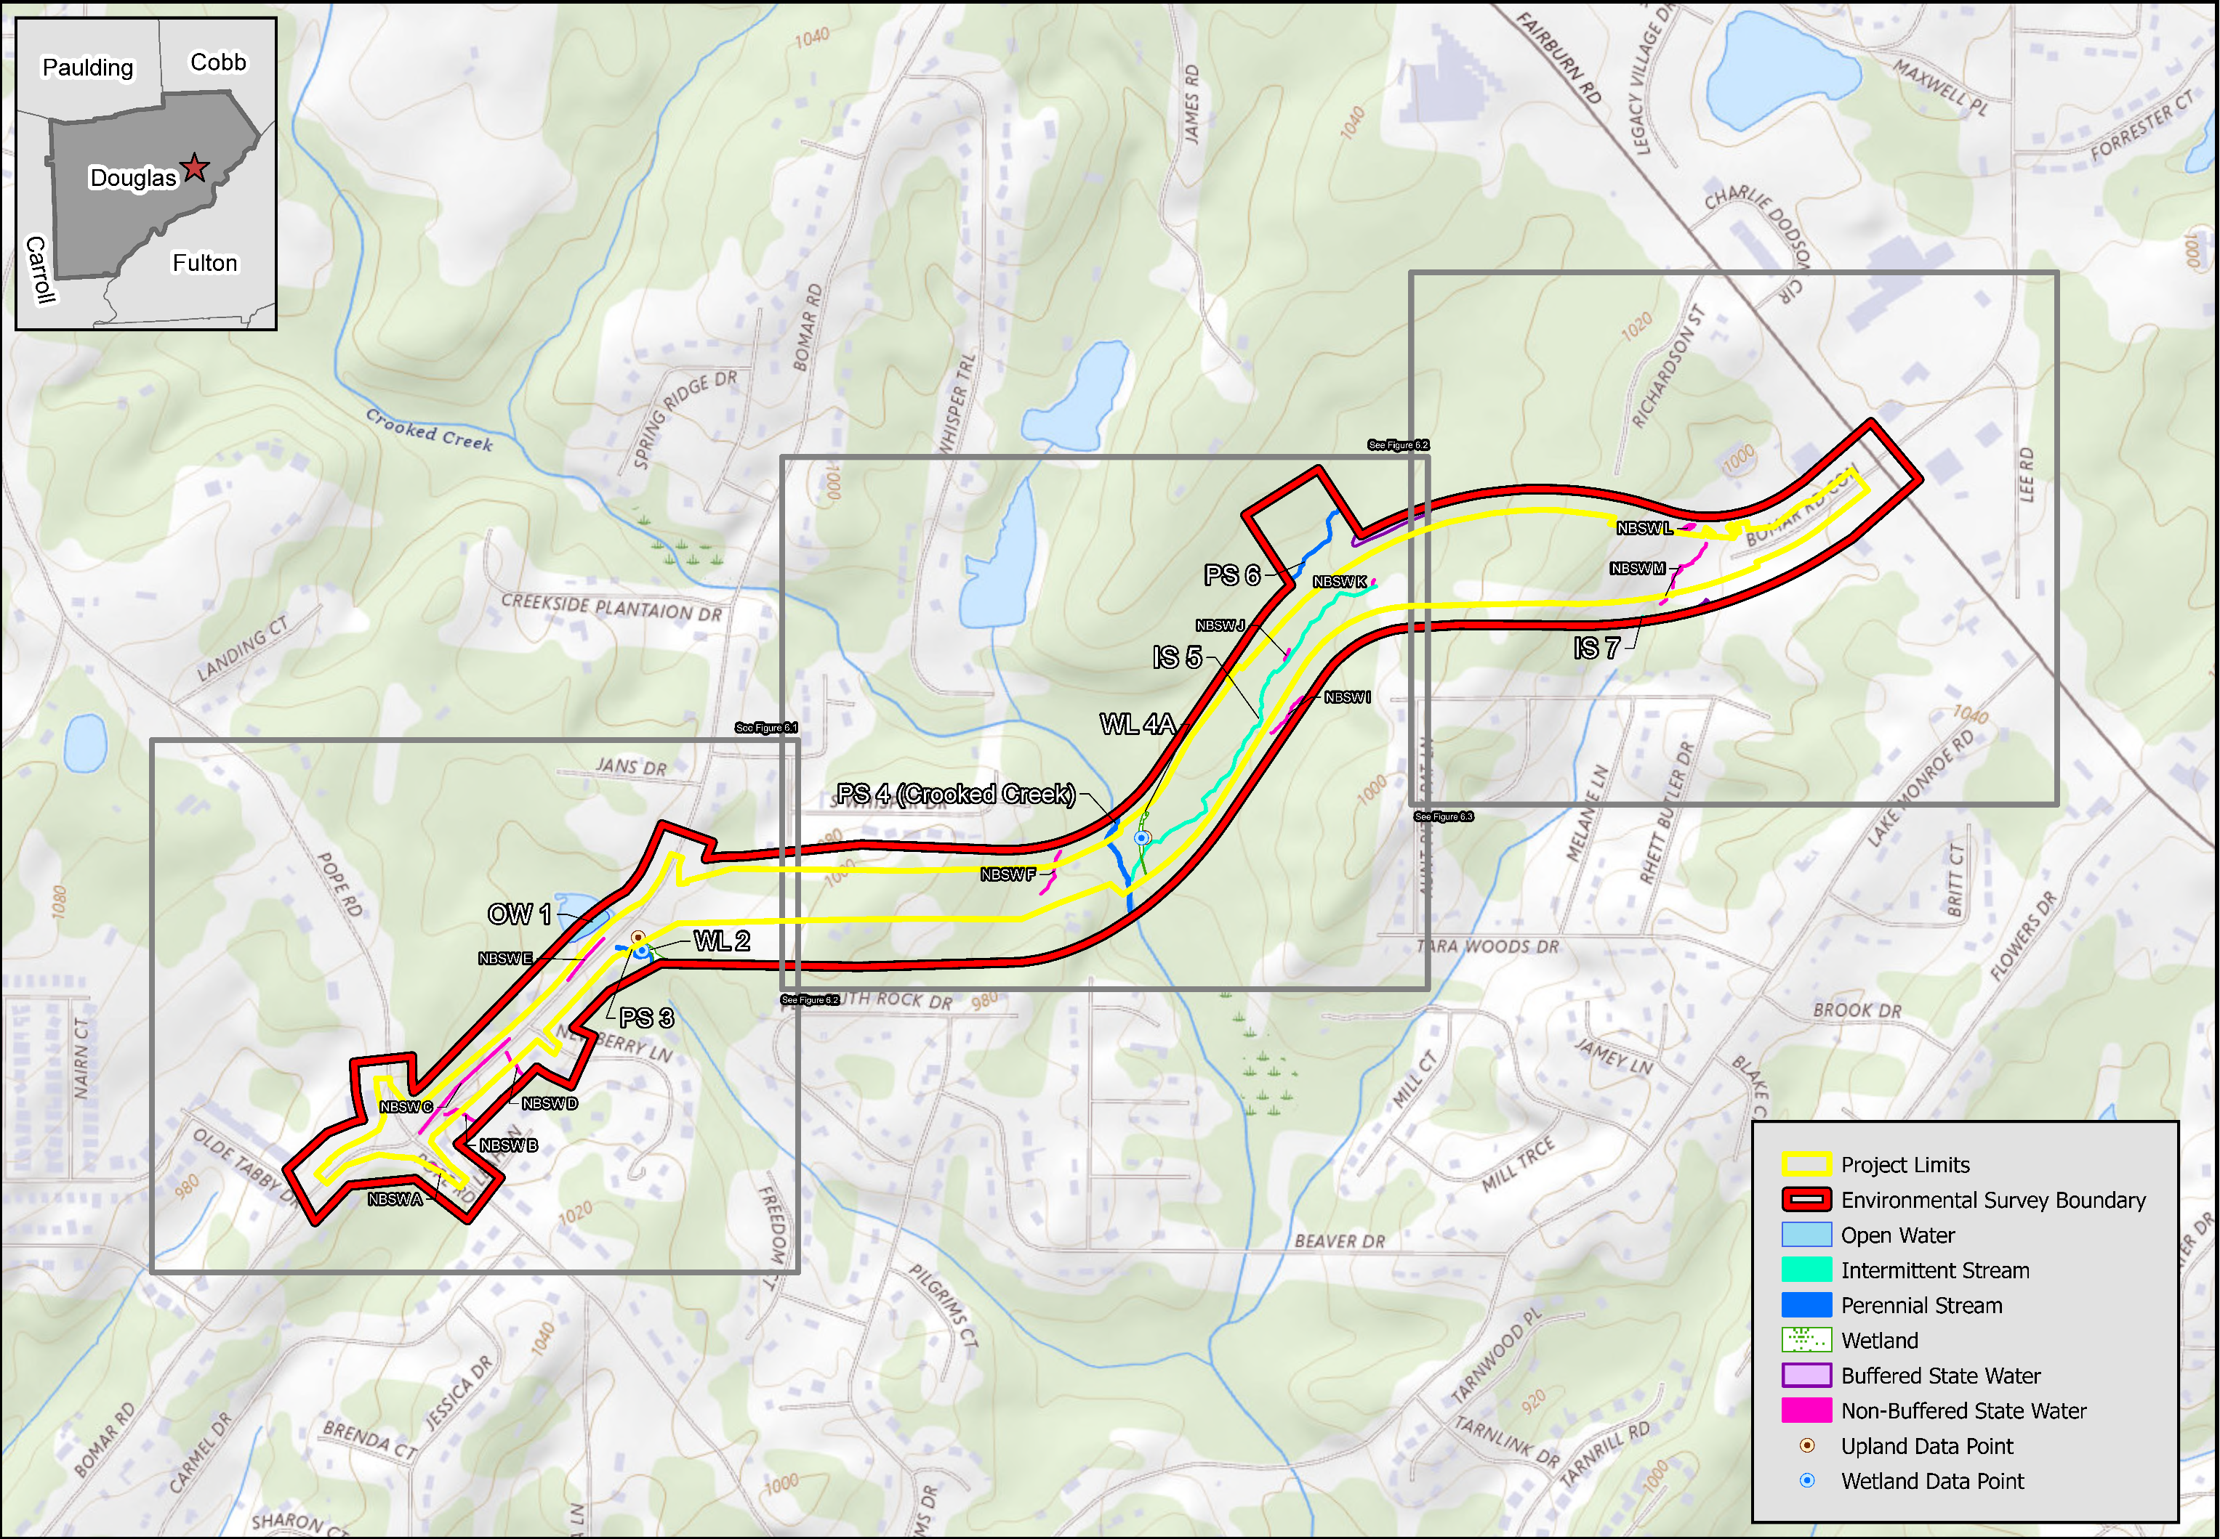
Environmental Findings: Natural Resources
Two jurisdictional wetlands and five jurisdictional streams were identified within the project’s Area of Potential Effects (APE)
An estimated 0.099 acre of wetlands and 2, 267 linear feet of streams would be impact by the proposed project.
A U.S. Army Corps of Engineers Section 404 permit would be required.

Slide 12
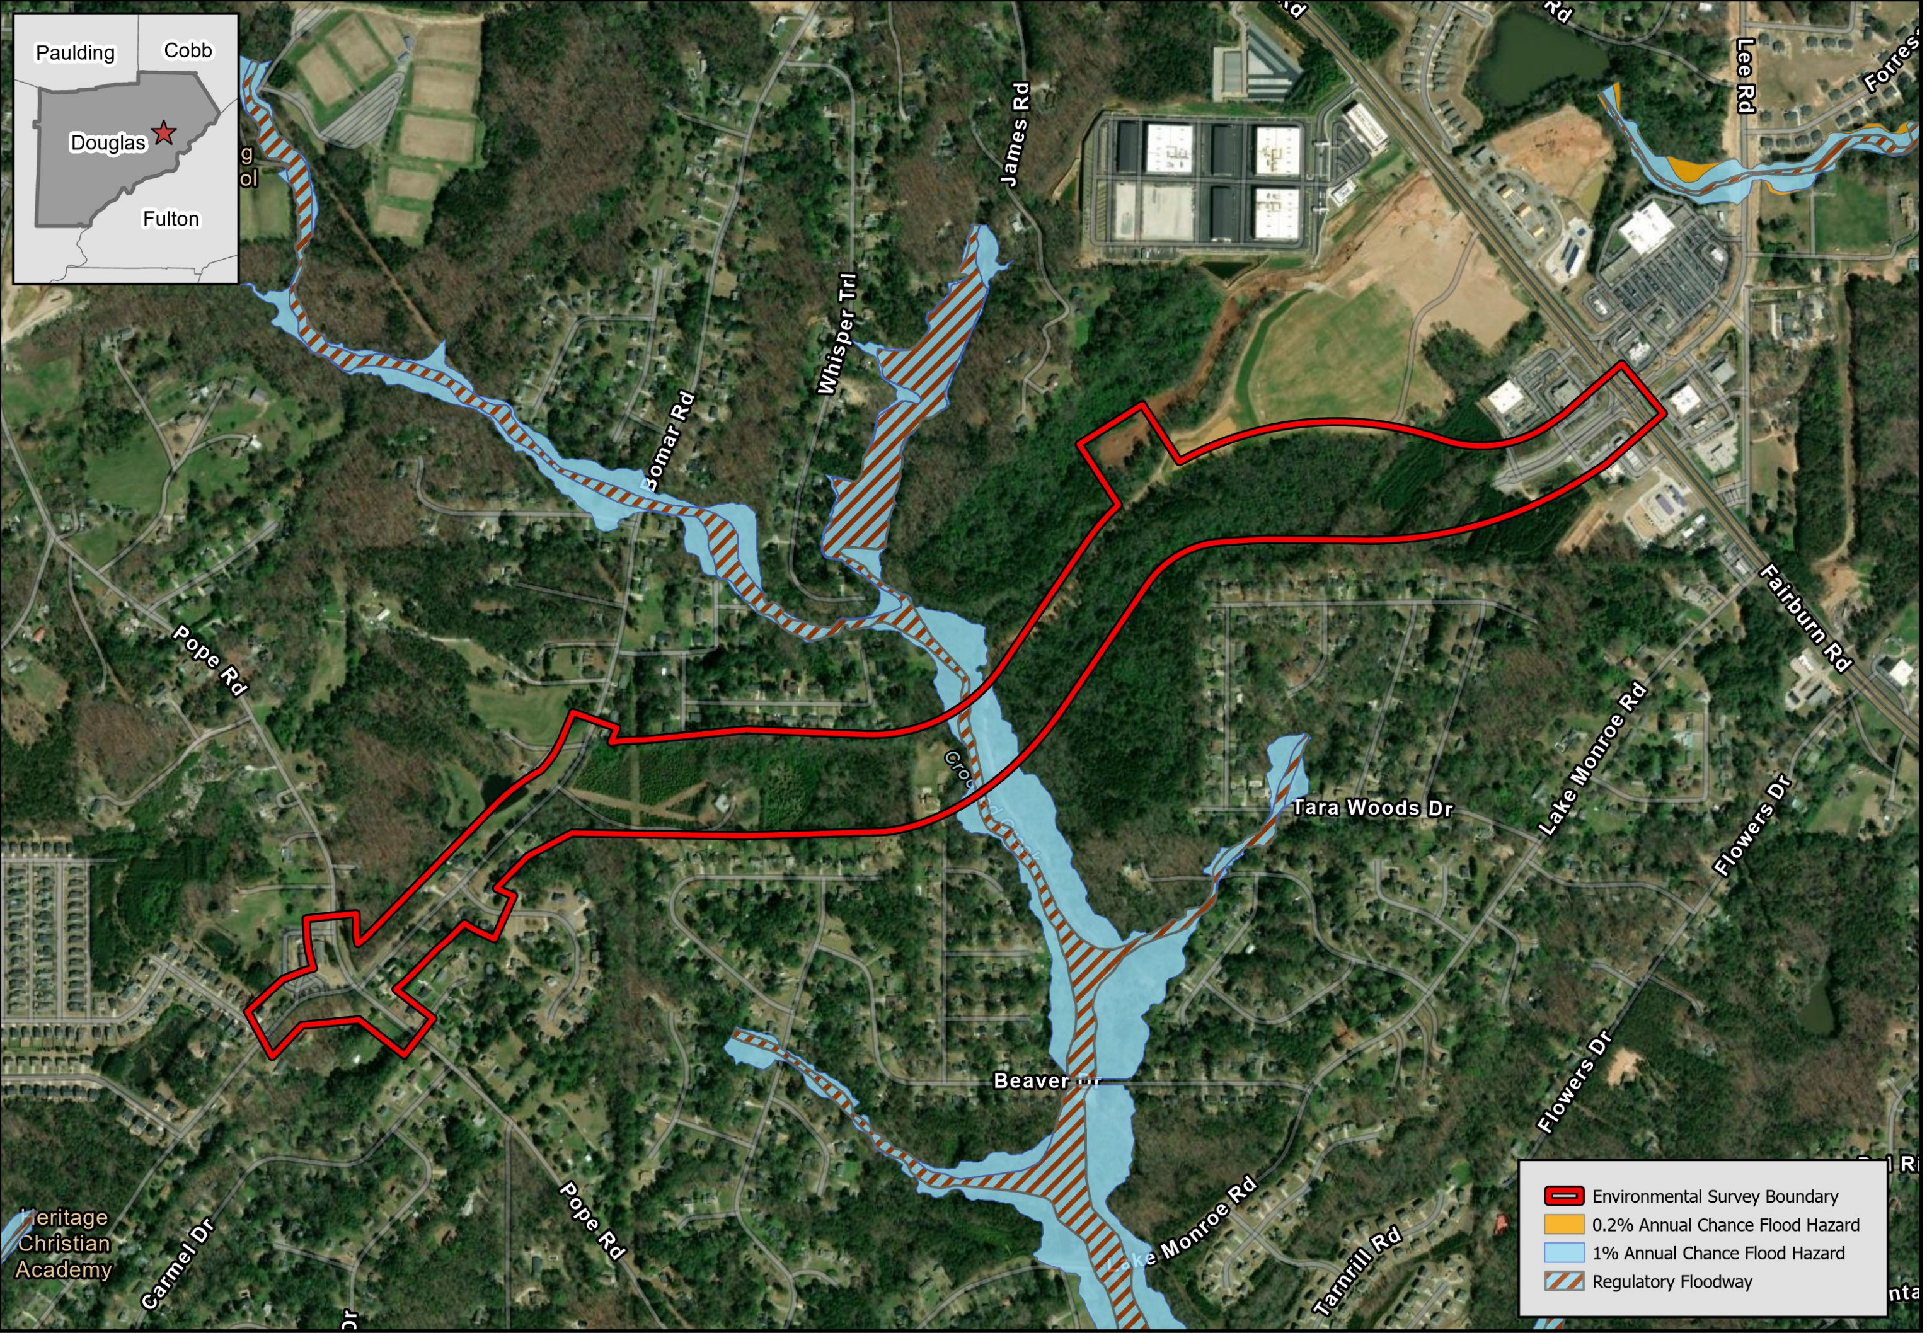
Environmental Findings: Flood Plain
A hydraulic study would be conducted to measure the resulting increases in floodplain and floodway elevations. It is expected that the proposed project would require a Conditional Letter of Map Revision (CLOMR)
CLOMR is required for floodplain elevation increases that exceed 0.04 foot and width increases that exceed one foot.

Slide 13
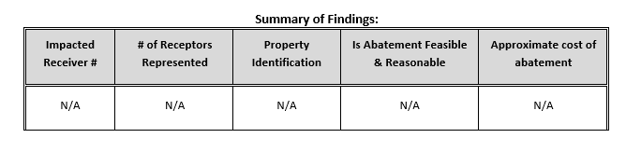

Environmental Findings: Air Quality and Noise
Noise
Air
The construction of this project would result in a seven decibel increase in traffic generated noise by the design year (2050)
No residence would approach or exceed the noise abatement criteria
No impacts were identified for this project; therefore, abatement measures were not considered.
The proposed project would not exceed state and federal air quality standards, and it is consistent with the State Implementation Plan for the attainment of clean air quality in the state

Slide 14

Environmental Findings: Cultural Resources
No existing or eligible resources were found to be located within the project’s APE.
Three archaeological sites of unknown eligibility were found within the project’s APE, but these resources were located beyond the project’s proposed construction limits
These archaeological sites will be protected with orange barrier fencing

Slide 15
Environmental Findings: Plants and Wildlife
The following federal and states protected species are expected to be impacted:
Species Name | Species Impact Expected
Federally Listed Species
Tricolored Bat (Perimyotis subflavus) | May Affect Likely to Adversely Affect
State Protected Species
Highscale shiner (Alburnops hypsilepis) | No Significant Adverse Effect
Chattahoochee crayfish (Cambarus howardi) | No Significant Adverse Effect
Pink ladyslipper (Cypripedium acaule) | No Significant Adverse Effect
Bay star-vine (Schisandra glabra) | No Significant Adverse Effect
Georgia aster (Symphyotrichum georgianum) | No Significant Adverse Effect

Slide 16

Environmental Findings: Hazardous Sites
The proposed project has been surveyed for potential sites where contaminated soil and/or water from leaking underground storage tanks may exist.
One potential site was identified and investigated. No indication of release or contamination above regulatory thresholds was determined.

Slide 17
Right-of-way Acquisition
No residences or businesses will be required to relocate
The Georgia Department of Transportation (GDOT) has the responsibility, once a project is approved, of appraising, purchasing required property
When purchasing property, the Georgia DOT desires to pay full market value for the necessary property. This value will be established by using qualified real estate appraisers who will prepare, for Georgia DOT’s use, written appraisals using actual sales data in the surrounding community
In this situation, when there are no relocations and only a part of the property is needed, Georgia DOT will purchase that part plus pay for loss of value, if any, to the remaining property.

Slide 18
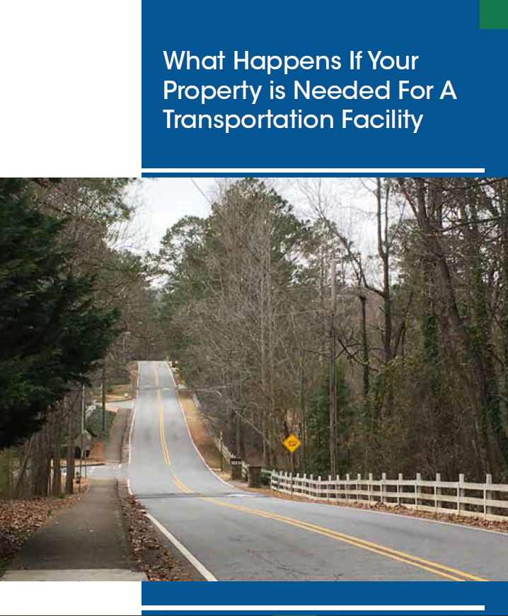
Right-of-way Acquisition
When the Georgia DOT purchases property, they will make additional payments to property owners for the cost of transferring ownership to the Georgia DOT. These costs generally include transfer taxes, deed-recording fees, mortgage pre-payment penalties and the pro-rata share of city or county taxes.
The information pamphlet “What Happens When Your Property is Needed for a Transportation Facility” is available. This booklet outlines the services offered and any payments for which you may be eligible, such as moving expenses and replacement housing benefits for owners and tenants. The brochure also outlines the eligibility requirements for receiving these payments.
More information about the Georgia DOT Right-of-Way process can be found at: https://www.dot.ga.gov/GDOT/pages/Rightofway.aspx
Please note: No relocations are required for the proposed project

Slide 19


How To Comment
A court reporter is available to record any verbal comments.
Comment cards can be dropped in the comment boxes at the center tables.
Online comments may be submitted to: https://www.douglascountyga.gov/894/0019889-Lee-Road-Extension-from-SR-92-to
Written comments can also be submitted to: Suleman Rana, Douglas County DOT, 4655 Timber Ridge Drive, Douglasville, Georgia 30135

