Slide 1

DOUGLAS COUNTY DEPARTMENT OF TRANSPORTATION
4655 TIMBER RIDGE DRIVE
DOUGLASVILLE, GEORGIA 30135
LOCAL POSTAL
CUSTOMER

Slide 2
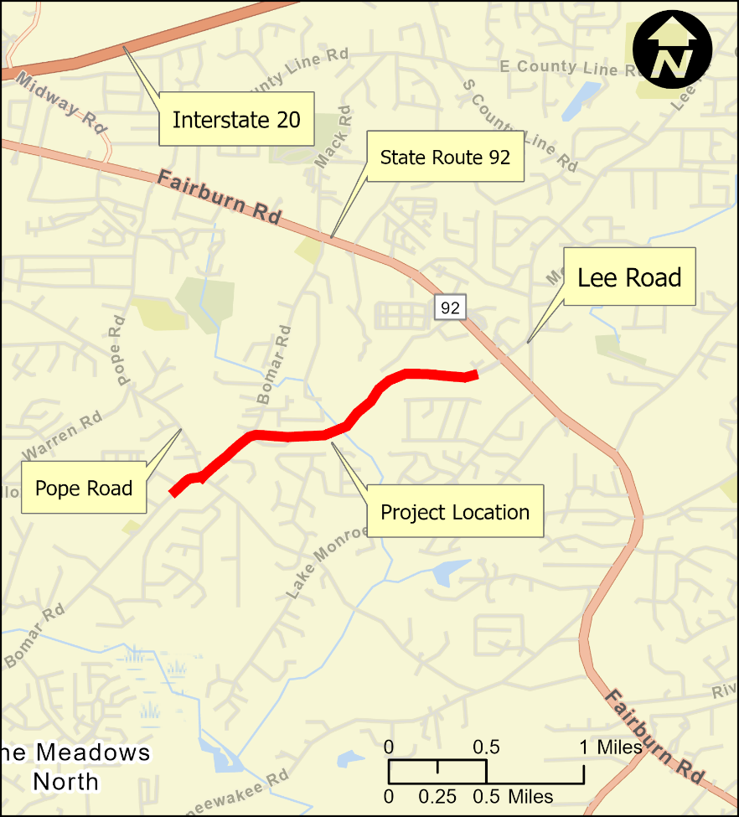
Collecting Feedback: Lee Road Extension, widening of Bomar Road and Environmental Document
Proposed Project (PI # 0019889): Douglas County has proposed widening Bomar Road from a two-lane roadway to a four-lane roadway and extending Lee Road to a new location. The proposed widening would start approximately 600 feet south of the Bomar Road at Pope Road intersection and continue north 1,550 feet. From that location, the project would continue on a new location to approximately 500 feet southwest of the State Route (SR) 92 at the Lee Road intersection. The proposed project is 1.7 miles long. The Douglas County Department of Transportation is seeking feedback about the proposed project and its environmental document.
On Thursday, March 24, 2026, Douglas County will hold a Public Information Open House meeting about the Project.
Please join us at Deer Lick Park Activity Center Gym, 2105 Mack Road, Douglasville, GA 30135, from 5:00 – 7:00 pm.
This meeting is informal, and the public is welcome to drop in anytime during this timeframe.
Comments will be accepted until April 03, 2026. Online Comments may be submitted at: https://www.douglascountyga.gov/894/0019889-Lee-Road-Extension-from-SR-92-to .Written statements can also be submitted to: Suleman Rana, 4655 Timber Ridge Drive, Douglasville, Georgia 30135
The meeting site is accessible to persons with disabilities. Further accommodations for people with disabilities can be requested with advance notice by contacting the Douglas County Department of Transportation in the following ways:
Questions, Concerns and ADA Requests:
Suleman Rana, MS, P.E,
Managing Director,
Douglas County Department of Transportation
(770)-920-4924
srana@douglascountyga.gov

