Slide 1
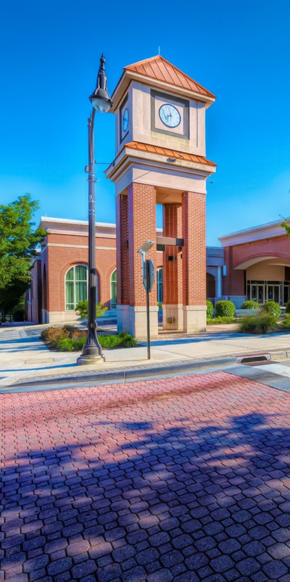





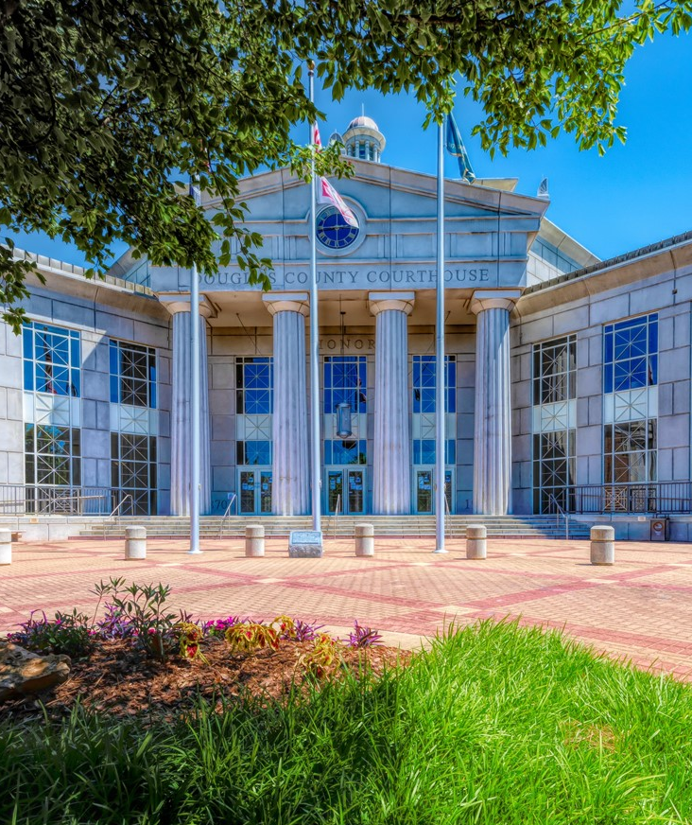
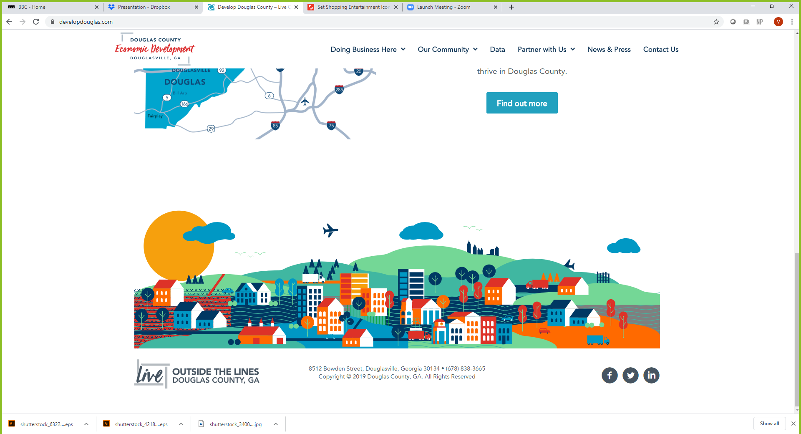
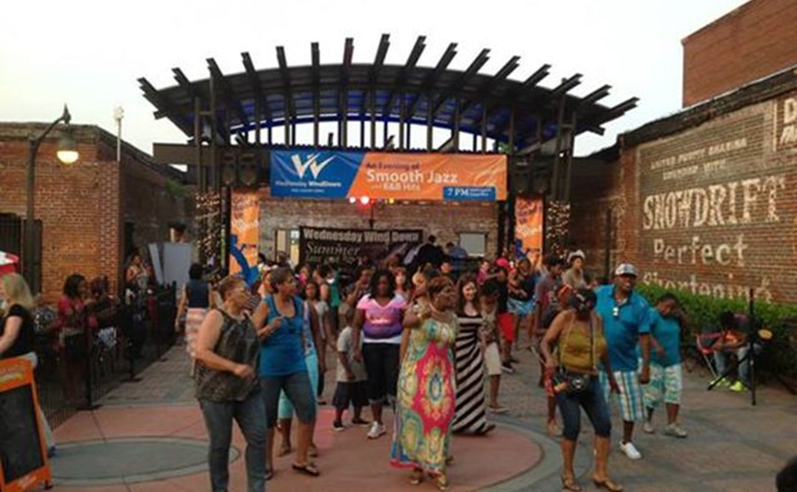

Foxhall Hotel & Conference Center

Slide 2
Foxhall Resort and Spa on Vimeo
Password: Foxhall2019

Slide 3


Slide 4


Slide 5
Executive Summary
The tax-exempt bond market has been strong, leading to several hotels getting financed in the market
The $218.5 million, 245 -room McLemore Hilton Conference Center Hotel was recently financed in August with a similar tax-exempt bond structure in Walker County, Georgia
McLemore incentives included a 30-year PILOT (100% for 5 years and 90% for the next 25 years); Hotel Motel Tax, DMO and TDA
Piper Sandler priced non-recourse tax-exempt and taxable bonds last month for the Marriott at the University of North Carolina Charlotte at an attractive 3.8% interest rate
Given the strength of the proposed Foxhall Project with the incentives, Piper Sandler is confident that the Foxhall Westin would successfully price based on current market conditions
The tax-exempt high yield bond market is subject to volatility at any moment, therefore, time is of the essence to finance the Foxhall Westin
Piper Sandler has evaluated a plan of finance for the Foxhall Westin that reduces the PILOT from 30-years (2016 IGA) to 5-years following by a 5% annual reduction in years 6-15
Reducing the PILOT to shorter than 30-years increases the risk that the bonds will not sell, but Piper Sandler believes that it is achievable if the current market conditions persist

Slide 6
Financing Overview
The Development Authority (“Authority”) of Douglas County would be the conduit issuer of tax-exempt bonds that will finance the construction of the hotel
The Bonds would not have any credit support from the County or the Authority
The Hotel and Conference Center will be owned by a public benefit non-profit company
The Bonds will be repaid by:
Net operating income of the hotel
4.00% Tourism Development Act (“TDA”)
4.50% Hotel Motel Tax (“HMT”)
3.50% Direct Marketing Organization (“DMO”) would be an offset to marketing expenses
100% PILOT payments equal to the property taxes levied on the Westin for five years and then decreasing by 5% a year from years 6-15.
The 2016 IGA included a 30-Year PILOT for 100% of the property taxes

Slide 7





Organizational Chart
BOND TRUSTEE
Hotel Net Revenues
Land Lease/ Resort Fee
Trust
Indenture
Tax Incentives
CONDUIT ISSUER
Development Authority of Douglas County
Development Agreement
Loan Agreement
BORROWER/OWNER
501(c)3
DEVELOPER (Allen Morris/ Merrill Trust)
Bond Purchase Agreement
Qualified Management Agreement
Construction Contract
OPERATOR
GENERAL CONTRACTOR
UNDERWRITER

Slide 8
Sample Flow of Funds

Slide 9
Preliminary Financing Overview
ASSUMPTIONS
3.0% cost of issuance and 10% of par debt service reserve fund (First Tier and Second Tier Bonds)
Projected operating performance/forecast provided by HEI
$2.500 million key money
Land contributed
Subordinate Management Fee (1.00% of Total Revenue) starts in operating year 5
Hotel Subordinate FF&E Reserve Deposit (2.00% of Total Revenue) starts in operating year 5
$3.500 million Operating Reserve; $1.500 million from bond proceeds
$5.000 million Cash Trap
First Tier Revenue Bonds
$96.935 million par amount
$71.532 million project fund deposit
4.50% Interest Rate
Debt Service Reserve Fund, earning 1.00% interest
Capitalized interest through 12/1/2024
2.0x minimum projected debt service coverage
1% annual growth in debt service
35 year term
Second Tier Revenue Bonds
$40.000 million par amount
$26.885 million project fund deposit
6.50% Interest Rate
Debt Service Reserve Fund, earning 1.00% interest
Capitalized interest through 12/1/2024
1.60x minimum projected debt service coverage
1% annual growth in debt service
30 year term
Third Tier Revenue Bonds
$4.058 million par amount
$3.940 million project fund deposit
10% Interest Rate
No capitalized interest
Interest accretion
4 year term

Slide 10
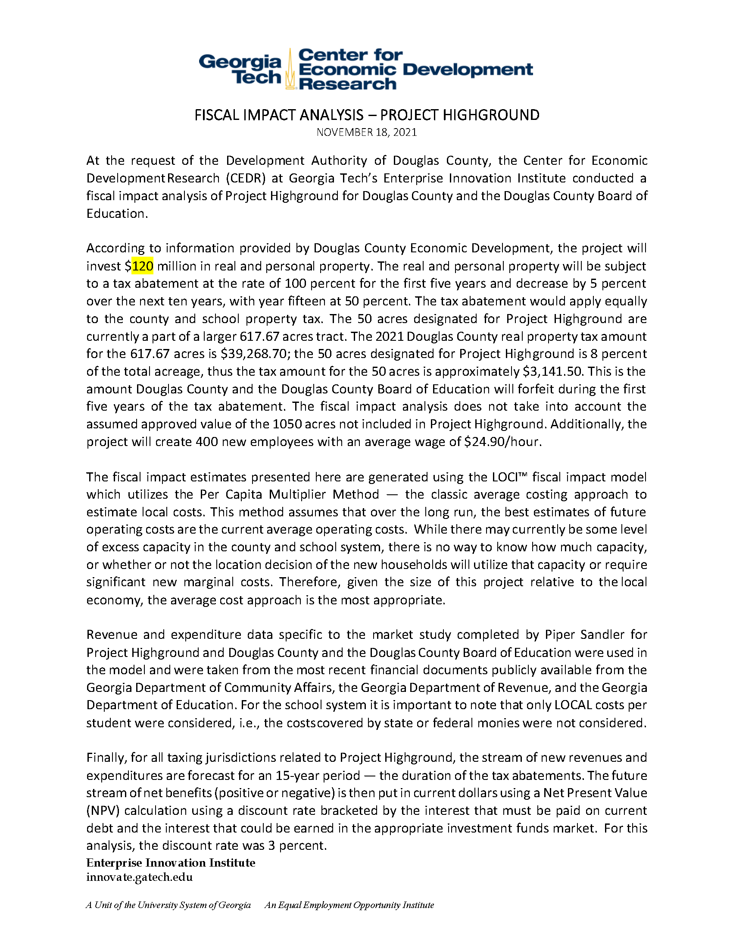

LOCI Fiscal Economic Impact Analysis
NPV of Benefit to Douglas County over 15 years is $32.1M

Slide 11
IGA Comparatives
2016 Agreement | New Agreement
95 Acres | 50 Acres
30-year 100% Abatement | 15- year Abatement; begins paying taxes in year 6
Roads built by Foxhall, transferred to the county as public roads to be maintained by county | Roads built by Foxhall, remain private and maintained by Foxhall, to standards of Fire & EMS
$40M Conduit Revenue Bonds for conference center | $175M Conduit Revenue Bonds for Hotel & Conference Center
 | Foxhall commits allowance of the BOC to utilize the Conference Center twice per year upon availability.

Slide 12
Series 2022 First Tier Hotel Revenue Bond Debt Service Summary
 |  |  |  |  |  |  |  | First Tier Bond Balance
Date | Total Revenue | EBITDA Less Reserves | TDA | Avail Cash Flow | First Tier Net DS | DSCR
2023 | $3,722,333 | $1,006,206 | $148,893 | $1,155,100 | $0 | - |  | $96,935,000
2024 | 22,898,667 | 6,257,654 | 915,947 | 7,173,601 | 0 | - |  | 96,935,000
2025 | 26,126,333 | 7,519,391 | 1,045,053 | 8,564,444 | (4,168,205) | 2.05x |  | 96,935,000
2026 | 28,485,667 | 8,487,070 | 1,139,427 | 9,626,496 | (4,453,205) | 2.16x |  | 96,650,000
2027 | 30,342,833 | 9,393,902 | 1,213,713 | 10,607,615 | (5,025,380) | 2.11x |  | 95,780,000
2028 | 31,316,946 | 9,733,607 | 1,252,678 | 10,986,285 | (5,076,230) | 2.16x |  | 94,820,000
2029 | 32,099,869 | 9,977,005 | 1,283,995 | 11,260,999 | (5,128,030) | 2.20x |  | 93,765,000
2030 | 32,902,366 | 10,226,714 | 1,316,095 | 11,542,809 | (5,180,555) | 2.23x |  | 92,610,000
2031 | 33,724,925 | 10,482,382 | 1,348,997 | 11,831,379 | (5,233,580) | 2.26x |  | 91,350,000
2032 | 34,568,049 | 10,744,442 | 1,382,722 | 12,127,164 | (5,286,880) | 2.29x |  | 89,980,000
2033 | 35,432,250 | 11,013,053 | 1,176,174 | 12,189,227 | (5,340,230) | 2.28x |  | 88,495,000
2034 | 36,318,056 | 11,288,379 | 0 | 11,288,379 | (5,393,405) | 2.09x |  | 86,890,000
2035 | 37,226,007 | 11,570,588 | 0 | 11,570,588 | (5,451,180) | 2.12x |  | 85,155,000
2036 | 38,156,658 | 11,859,853 | 0 | 11,859,853 | (5,503,105) | 2.16x |  | 83,290,000
2037 | 39,110,574 | 12,156,349 | 0 | 12,156,349 | (5,559,180) | 2.19x |  | 81,285,000
2038 | 40,088,338 | 12,460,258 | 0 | 12,460,258 | (5,618,955) | 2.22x |  | 79,130,000
2039 | 41,090,547 | 12,771,765 | 0 | 12,771,765 | (5,671,980) | 2.25x |  | 76,825,000
2040 | 42,117,810 | 13,091,059 | 0 | 13,091,059 | (5,733,255) | 2.28x |  | 74,355,000
2041 | 43,170,756 | 13,418,335 | 0 | 13,418,335 | (5,792,105) | 2.32x |  | 71,715,000
2042 | 44,250,025 | 13,753,794 | 0 | 13,753,794 | (5,848,305) | 2.35x |  | 68,900,000
2043 | 45,356,275 | 14,097,638 | 0 | 14,097,638 | (5,906,630) | 2.39x |  | 65,900,000
2044 | 46,490,182 | 14,450,079 | 0 | 14,450,079 | (5,966,630) | 2.42x |  | 62,705,000
2045 | 47,652,437 | 14,811,331 | 0 | 14,811,331 | (6,027,855) | 2.46x |  | 59,305,000
2046 | 48,843,748 | 15,181,615 | 0 | 15,181,615 | (6,089,855) | 2.49x |  | 55,690,000
2047 | 50,064,841 | 15,561,155 | 0 | 15,561,155 | (6,152,180) | 2.53x |  | 51,850,000
2048 | 51,316,462 | 15,950,184 | 0 | 15,950,184 | (6,214,380) | 2.57x |  | 47,775,000
2049 | 52,599,374 | 16,348,938 | 0 | 16,348,938 | (6,276,005) | 2.60x |  | 43,455,000
2050 | 53,914,358 | 16,757,662 | 0 | 16,757,662 | (6,341,605) | 2.64x |  | 38,875,000
2051 | 55,262,217 | 17,176,604 | 0 | 17,176,604 | (6,405,505) | 2.68x |  | 34,025,000
2052 | 56,643,773 | 17,606,019 | 0 | 17,606,019 | (6,472,255) | 2.72x |  | 28,890,000
2053 | 58,059,867 | 18,046,169 | 0 | 18,046,169 | (6,536,180) | 2.76x |  | 23,460,000
2054 | 59,511,364 | 18,497,323 | 0 | 18,497,323 | (6,601,830) | 2.80x |  | 17,720,000
2055 | 60,999,148 | 18,959,756 | 0 | 18,959,756 | (6,668,530) | 2.84x |  | 11,655,000
2056 | 62,524,126 | 19,433,750 | 0 | 19,433,750 | (2,292,105) | 8.48x |  | 0

Slide 13
Series 2022 Second Tier Bond Debt Service Summary
Date | EBITDA Less Reserves | HOT | DMO | PILOT | TDA | Cash for CC Bonds | First Tier Net Debt Service | Second Tier Net Debt Service | DSCR |  | Second Tier Balance | Cumulative Balance
2023 | $1,006,206 | $96,000 | $74,667 | $131,000 | $148,893 | $1,456,766 | $0 | $0 | - |  | $40,000,000 | $136,935,000
2024 | 6,257,654 | 590,813 | 459,521 | 789,333 | 915,947 | 9,013,267 | 0 | 0 | - |  | 40,000,000 | 136,935,000
2025 | 7,519,391 | 675,930 | 525,723 | 809,333 | 1,045,053 | 10,575,431 | (4,168,205) | (1,436,667) | 1.89x |  | 40,000,000 | 136,935,000
2026 | 8,487,070 | 741,435 | 576,672 | 829,500 | 1,139,427 | 11,774,103 | (4,453,205) | (2,595,000) | 1.67x |  | 39,925,000 | 136,575,000
2027 | 9,393,902 | 797,453 | 620,241 | 850,500 | 1,213,713 | 12,875,808 | (5,025,380) | (2,920,125) | 1.62x |  | 39,520,000 | 135,300,000
2028 | 9,733,607 | 825,214 | 641,833 | 864,203 | 1,252,678 | 13,317,535 | (5,076,230) | (2,948,800) | 1.66x |  | 39,060,000 | 133,880,000
2029 | 9,977,005 | 845,844 | 657,879 | 841,137 | 1,283,995 | 13,605,860 | (5,128,030) | (2,973,900) | 1.68x |  | 38,545,000 | 132,310,000
2030 | 10,226,714 | 866,991 | 674,326 | 816,379 | 1,316,095 | 13,900,504 | (5,180,555) | (3,005,425) | 1.70x |  | 37,965,000 | 130,575,000
2031 | 10,482,382 | 888,665 | 691,184 | 789,856 | 1,348,997 | 14,201,085 | (5,233,580) | (3,037,725) | 1.72x |  | 37,315,000 | 128,665,000
2032 | 10,744,442 | 910,882 | 708,464 | 761,498 | 1,382,722 | 14,508,007 | (5,286,880) | (3,070,475) | 1.74x |  | 36,590,000 | 126,570,000
2033 | 11,013,053 | 933,654 | 726,175 | 731,227 | 1,176,174 | 14,580,284 | (5,340,230) | (3,098,350) | 1.73x |  | 35,790,000 | 124,285,000
2034 | 11,288,379 | 956,995 | 744,330 | 698,968 | 0 | 13,688,672 | (5,393,405) | (3,126,350) | 1.61x |  | 34,910,000 | 121,800,000
2035 | 11,570,588 | 980,920 | 762,938 | 664,638 | 0 | 13,979,084 | (5,451,180) | (3,159,150) | 1.62x |  | 33,940,000 | 119,095,000
2036 | 11,859,853 | 1,005,443 | 782,011 | 628,155 | 0 | 14,275,463 | (5,503,105) | (3,191,100) | 1.64x |  | 32,875,000 | 116,165,000
2037 | 12,156,349 | 1,030,579 | 801,562 | 589,432 | 0 | 14,577,923 | (5,559,180) | (3,216,875) | 1.66x |  | 31,715,000 | 113,000,000
2038 | 12,460,258 | 1,056,344 | 821,601 | 462,964 | 0 | 14,801,167 | (5,618,955) | (3,256,475) | 1.67x |  | 30,440,000 | 109,570,000
2039 | 12,771,765 | 1,082,752 | 842,141 | 0 | 0 | 14,696,658 | (5,671,980) | (3,288,600) | 1.64x |  | 29,050,000 | 105,875,000
2040 | 13,091,059 | 1,109,821 | 863,194 | 0 | 0 | 15,064,074 | (5,733,255) | (3,318,250) | 1.66x |  | 27,540,000 | 101,895,000
2041 | 13,418,335 | 1,137,567 | 884,774 | 0 | 0 | 15,440,676 | (5,792,105) | (3,350,100) | 1.69x |  | 25,900,000 | 97,615,000
2042 | 13,753,794 | 1,166,006 | 906,894 | 0 | 0 | 15,826,693 | (5,848,305) | (3,383,500) | 1.71x |  | 24,120,000 | 93,020,000
2043 | 14,097,638 | 1,195,156 | 929,566 | 0 | 0 | 16,222,360 | (5,906,630) | (3,417,800) | 1.74x |  | 22,190,000 | 88,090,000
2044 | 14,450,079 | 1,225,035 | 952,805 | 0 | 0 | 16,627,919 | (5,966,630) | (3,452,350) | 1.77x |  | 20,100,000 | 82,805,000
2045 | 14,811,331 | 1,255,661 | 976,625 | 0 | 0 | 17,043,617 | (6,027,855) | (3,486,500) | 1.79x |  | 17,840,000 | 77,145,000
2046 | 15,181,615 | 1,287,052 | 1,001,041 | 0 | 0 | 17,469,708 | (6,089,855) | (3,519,600) | 1.82x |  | 15,400,000 | 71,090,000
2047 | 15,561,155 | 1,319,229 | 1,026,067 | 0 | 0 | 17,906,451 | (6,152,180) | (3,561,000) | 1.84x |  | 12,760,000 | 64,610,000
2048 | 15,950,184 | 1,352,209 | 1,051,718 | 0 | 0 | 18,354,112 | (6,214,380) | (3,594,400) | 1.87x |  | 9,915,000 | 57,690,000
2049 | 16,348,938 | 1,386,015 | 1,078,011 | 0 | 0 | 18,812,965 | (6,276,005) | (3,629,475) | 1.90x |  | 6,850,000 | 50,305,000
2050 | 16,757,662 | 1,420,665 | 1,104,962 | 0 | 0 | 19,283,289 | (6,341,605) | (3,660,250) | 1.93x |  | 3,555,000 | 42,430,000
2051 | 17,176,604 | 1,456,182 | 1,132,586 | 0 | 0 | 19,765,371 | (6,405,505) | 293,925 | 3.23x |  | 0 | 34,025,000
2052 | 17,606,019 | 1,492,586 | 1,160,900 | 0 | 0 | 20,259,505 | (6,472,255) | 0 | - |  | 0 | 28,890,000
2053 | 18,046,169 | 1,269,627 | 987,488 | 0 | 0 | 20,303,284 | (6,536,180) | 0 | - |  | 0 | 23,460,000
2054 | 18,497,323 | 0 | 0 | 0 | 0 | 18,497,323 | (6,601,830) | 0 | - |  | 0 | 17,720,000
2055 | 18,959,756 | 0 | 0 | 0 | 0 | 18,959,756 | (6,668,530) | 0 | - |  | 0 | 11,655,000
2056 | 19,433,750 | 0 | 0 | 0 | 0 | 19,433,750 | (2,292,105) | 0 | - |  | 0 | 0

Slide 14
Debt Service Tier 3 Summary
 | Available Revenue after Second Tier Bonds
Date |  | Sub Mngmt* | Sub FF&E** | Operating Reserve (from CF) | Cash Trap Reserve | Available Cash Flow for Tier 3 | Tier 3 Debt Balance | Annual Excess Cash Flow after Tier 3 | Cumulative Excess Cash after Tier 3
2023 | $1,456,766 | $0 | $0 | ($1,456,766) | $0 | ($0) | $5,401,464 | $0 | $0
2024 | 9,013,267 | 0 | 0 | ($543,234) | (5,000,000) | 3,470,034 | 2,471,577 | 0 | 0
2025 | 4,970,559 | 0 | 0 | 0 | 0 | 4,970,559 | 0 | 2,251,825 | 2,251,825
2026 | 4,725,898 | 0 | 0 | 0 | 0 | 4,725,898 | 0 | 4,725,898 | 6,977,723
2027 | 4,930,303 | (303,428) | (606,857) | 0 | 0 | 4,020,018 | 0 | 4,020,018 | 10,997,741
2028 | 5,292,505 | (313,169) | (626,339) | 0 | 0 | 4,352,997 | 0 | 4,352,997 | 15,350,738
2029 | 5,503,930 | (320,999) | (641,997) | 0 | 0 | 4,540,934 | 0 | 4,540,934 | 19,891,671
2030 | 5,714,524 | (329,024) | (658,047) | 0 | 0 | 4,727,453 | 0 | 4,727,453 | 24,619,124
2031 | 5,929,780 | (337,249) | (674,499) | 0 | 0 | 4,918,032 | 0 | 4,918,032 | 29,537,156
2032 | 6,150,652 | (345,680) | (691,361) | 0 | 0 | 5,113,610 | 0 | 5,113,610 | 34,650,767
2033 | 6,141,704 | (354,322) | (708,645) | 0 | 0 | 5,078,736 | 0 | 5,078,736 | 39,729,503
2034 | 5,168,917 | (363,181) | (726,361) | 0 | 0 | 4,079,375 | 0 | 4,079,375 | 43,808,878
2035 | 5,368,754 | (372,260) | (744,520) | 0 | 0 | 4,251,974 | 0 | 4,251,974 | 48,060,852
2036 | 5,581,258 | (381,567) | (763,133) | 0 | 0 | 4,436,558 | 0 | 4,436,558 | 52,497,410
2037 | 5,801,868 | (391,106) | (782,211) | 0 | 0 | 4,628,550 | 0 | 4,628,550 | 57,125,960
2038 | 5,925,737 | (400,883) | (801,767) | 0 | 0 | 4,723,087 | 0 | 4,723,087 | 61,849,047
2039 | 5,736,078 | (410,905) | (821,811) | 0 | 0 | 4,503,361 | 0 | 4,503,361 | 66,352,408
2040 | 6,012,569 | (421,178) | (842,356) | 0 | 0 | 4,749,035 | 0 | 4,749,035 | 71,101,443
2041 | 6,298,471 | (431,708) | (863,415) | 0 | 0 | 5,003,348 | 0 | 5,003,348 | 76,104,792
2042 | 6,594,888 | (442,500) | (885,000) | 0 | 0 | 5,267,387 | 0 | 5,267,387 | 81,372,179
2043 | 6,897,930 | (453,563) | (907,126) | 0 | 0 | 5,537,242 | 0 | 5,537,242 | 86,909,421
2044 | 7,208,939 | (464,902) | (929,804) | 0 | 0 | 5,814,234 | 0 | 5,814,234 | 92,723,655
2045 | 7,529,262 | (476,524) | (953,049) | 0 | 0 | 6,099,689 | 0 | 6,099,689 | 98,823,344
2046 | 7,860,253 | (488,437) | (976,875) | 0 | 0 | 6,394,940 | 0 | 6,394,940 | 105,218,285
2047 | 8,193,271 | (500,648) | (1,001,297) | 0 | 0 | 6,691,325 | 0 | 6,691,325 | 111,909,610
2048 | 8,545,332 | (513,165) | (1,026,329) | 0 | 0 | 7,005,838 | 0 | 7,005,838 | 118,915,448
2049 | 8,907,485 | (525,994) | (1,051,987) | 0 | 0 | 7,329,503 | 0 | 7,329,503 | 126,244,951
2050 | 9,281,434 | (539,144) | (1,078,287) | 0 | 0 | 7,664,003 | 0 | 7,664,003 | 133,908,954
2051 | 13,653,791 | (552,622) | (1,105,244) | 0 | 0 | 11,995,924 | 0 | 11,995,924 | 145,904,879
2052 | 13,787,250 | (566,438) | (1,132,875) | 0 | 0 | 12,087,937 | 0 | 12,087,937 | 157,992,816
2053 | 13,767,104 | (580,599) | (1,161,197) | 0 | 0 | 12,025,308 | 0 | 12,025,308 | 170,018,124
2054 | 11,895,493 | (595,114) | (1,190,227) | 0 | 0 | 10,110,152 | 0 | 10,110,152 | 180,128,276
2055 | 12,291,226 | (609,991) | (1,219,983) | 0 | 0 | 10,461,252 | 0 | 10,461,252 | 190,589,528
2056 | 17,141,645 | (625,241) | (1,250,483) | 0 | 0 | 15,265,921 | 0 | 15,265,921 | 205,855,450

