Slide 1

2021 DOUGLAS COUNTY
REDISTRICTING

Slide 2
DOUGLAS COUNTY POPULATION
Year Population
2010 132,403
2020 144,237

Slide 3
DOUGLAS COUNTY POPULATION
Increase %Increase
11,834 8.9%

Slide 4
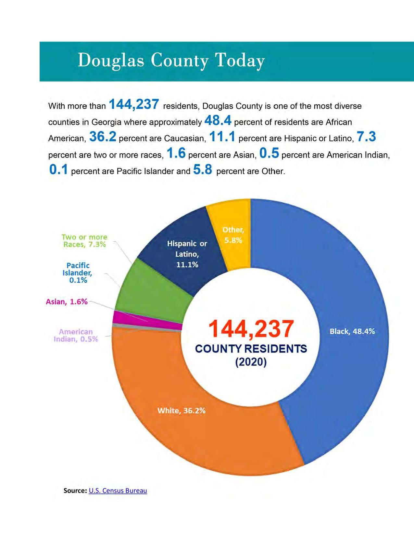
DOUGLAS COUNTY
2020 CENSUS DATA

Slide 5
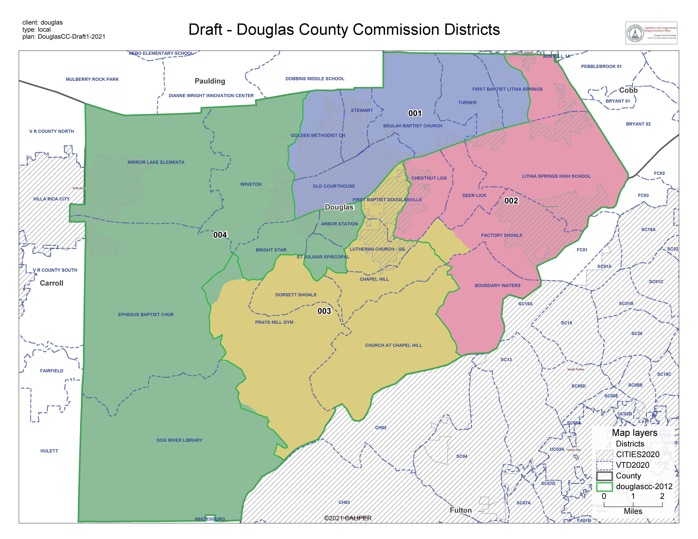
DOUGLAS
COUNTY
2021

Slide 6
Area of Change D2/D3

Slide 7
Area of Change
D3/D4

Slide 8
2021 Ideal District Size= 36,059
District Pop. Deviation %Deviation
(1) 36,106 +47 0.13%
(2) 36,191 +132 0.37%
(3) 36,032 -27 -0.07%
(4) 35,908 -151 -0.42%

Slide 9
2011 Ideal District Size= 33,100
District Pop. Deviation %Deviation
(1) 33,890 +790 2.39%
(2) 33,843 +743 2.24%
(3) 32,515 -585 -1.77%
(4) 32,155 -945 -2.85%

Slide 10
DOUGLAS COUNTY REDISTRICTING
NEXT STEPS
Advertise for a public hearing to be held on January 4th
Provide locations for the citizens to view the map
Hold the public hearing to get citizen input
Board of Commissioners will vote on the approval of
the map

Slide 11
DOUGLAS COUNTY REDISTRICTING
NEXT STEPS
Advertise a notice to introduce local legislation-Jan. 6th
Local legislation is filed by the County’s Legislative Sponsor
The legislation is voted on by the General Assembly
The map becomes official with passage from the
General Assembly and the Governor’s Signature

Slide 12
DOUGLAS COUNTY
REDISTRICTING

Slide 13
DISTRICT POPULATION CHANGES
District 2011 Pop. 2021 Pop. Increase
(1) 33,890 36,106 2,216
(2) 33,843 36,191 2,348
(3) 32,515 36,032 3,517
(4) 32,155 35,908 3,753

