Slide 1
Public Health Updates for Douglas County
July 26, 2022

Slide 2
MONKEYPOX

Slide 3

Monkeypox /WHO
July 23, 2022-Public Health Emergency of International Concern

Slide 4
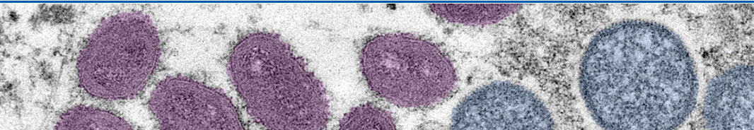
Background
Monkeypox is a rare disease caused by infection with the monkeypox virus. ​
Monkeypox virus belongs to the Orthopoxvirus genus in the family Poxviridae. ​​
Includes variola virus (which causes smallpox), vaccinia virus (used in the smallpox vaccine), and cowpox virus. ​
Monkeypox is not related to chickenpox.​​
The source of the disease remains unknown. However, African rodents and non-human primates (like monkeys) may harbor the virus and infect people.​
The first human case of monkeypox was recorded in 1970. Monkeypox has been reported in people in several central and western African countries. ​​
Prior to the 2022 outbreak, nearly all monkeypox cases in people outside of Africa were linked to international travel to countries where the disease commonly occurs, or through imported animals.​
​

Slide 5
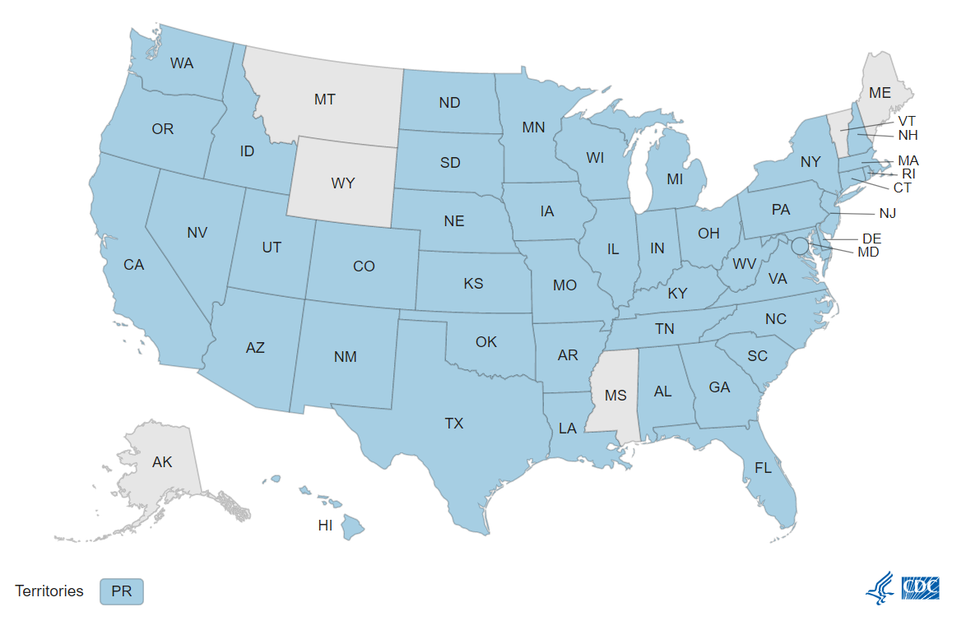
Current Outbreak in U.S.
3.487 cases in the US​
268 in GA​ (as of 7/25)
2 children in U.S. ​​
No longer only travel-related
Early data suggest that gay, bisexual, and other men who have sex with men make up a high number of cases​​
However, anyone who has been in close contact with someone who has monkeypox is at risk
https://www.cdc.gov/poxvirus/monkeypox/response/2022/us-map.html
Notes:
https://www.cdc.gov/poxvirus/monkeypox/index.html

Slide 6
Transmission
Usually Direct Contact with infectious rash, scabs, or body fluids​​
May be contact with infected linens, clothing​​
Through respiratory secretions during prolonged, face-to-face contact, or during intimate physical contact, such as kissing, cuddling, or sex​​
Transovarial transmission to the fetus through the placenta​​
From infected animals, either by being scratched or bitten by the animal or by eating meat or using products from an infected animal
Monkeypox can spread from the time symptoms start until the rash has fully healed and a fresh layer of skin has formed (*Patients are to remain on isolation until a fresh layer of skin forms – this is 2 - 4 weeks)

Slide 7
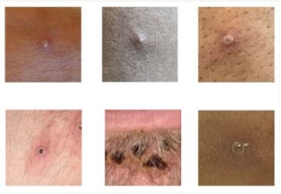
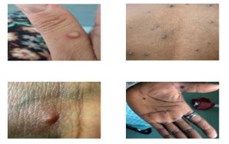
Clinical Information
Symptoms can include:
Fever
Headache
Muscle aches and backache
Swollen lymph nodes
Chills
Exhaustion
A rash that can look like pimples or blisters that appears on the face, inside the mouth, and on other parts of the body, like the hands, feet, chest, genitals, or anus.
The rash goes through different stages before healing completely (2-4 weeks). Sometimes, people get a rash first, followed by other symptoms. Others only experience a rash.
Monkeypox rash at various stages
Notes:
https://www.cdc.gov/poxvirus/monkeypox/symptoms.html

Slide 8
Testing
If suspected case:
Reach out to healthcare provider
Cobb & Douglas Public Health (770-514-2300)
Commercial testing and Public Health Lab testing available
Isolate if you think you are a suspected case

Slide 9
Case Follow-up
Current isolation = 2 - 4 weeks
Georgia DPH guidance: https://dph.georgia.gov/monkeypox
Treatment (TPOXX) available for cases at risk of severe disease – public health consult required
Post-exposure prophylaxis (Jynneos vaccine) available for high-risk close contacts – public health consult required (limited supplies)
Up to 4 days after exposure to prevent disease
Up to 14 days after exposure to abate symptoms

Slide 10
COVID-19 UPDATE

Slide 11
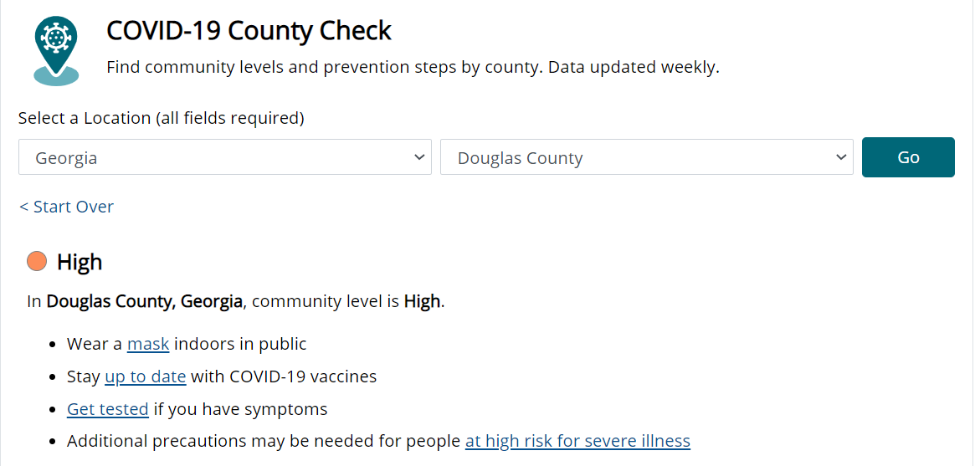
Douglas County is back in HIGH transmission
Notes:
Link to source:
https://www.cdc.gov/coronavirus/2019-ncov/science/community-levels.html

Slide 12
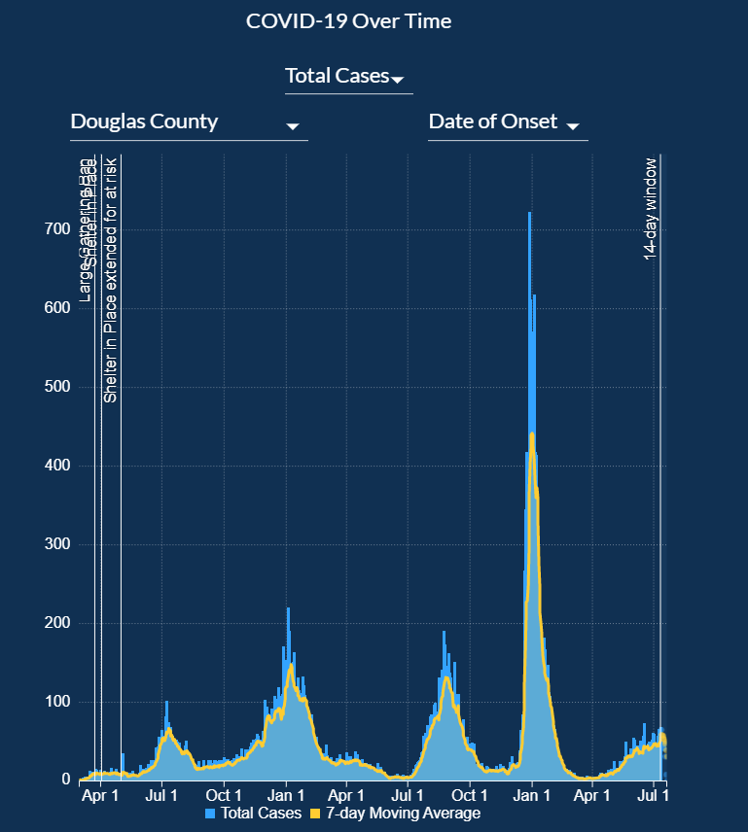
Notes:
https://dph.georgia.gov/covid-19-daily-status-report

Slide 13
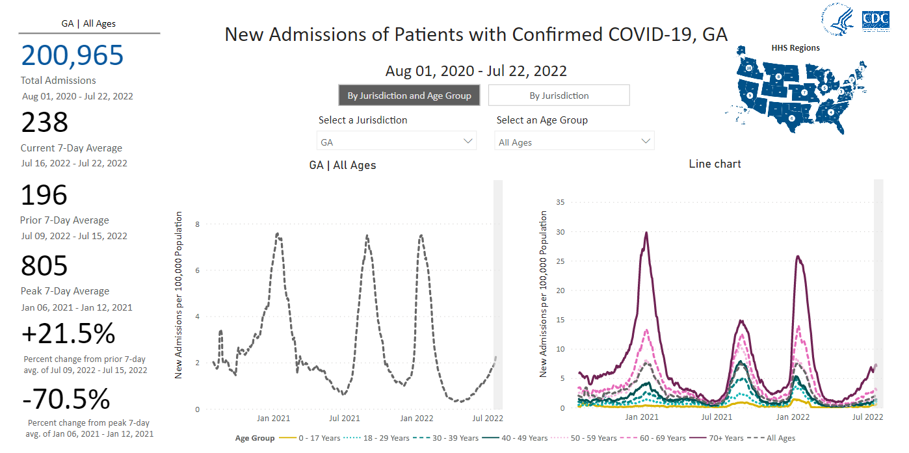
In Georgia, the number of COVID hospitalizations are once again increasing.
Notes:
Link to map source: https://covid.cdc.gov/covid-data-tracker/#new-hospital-admissions

Slide 14
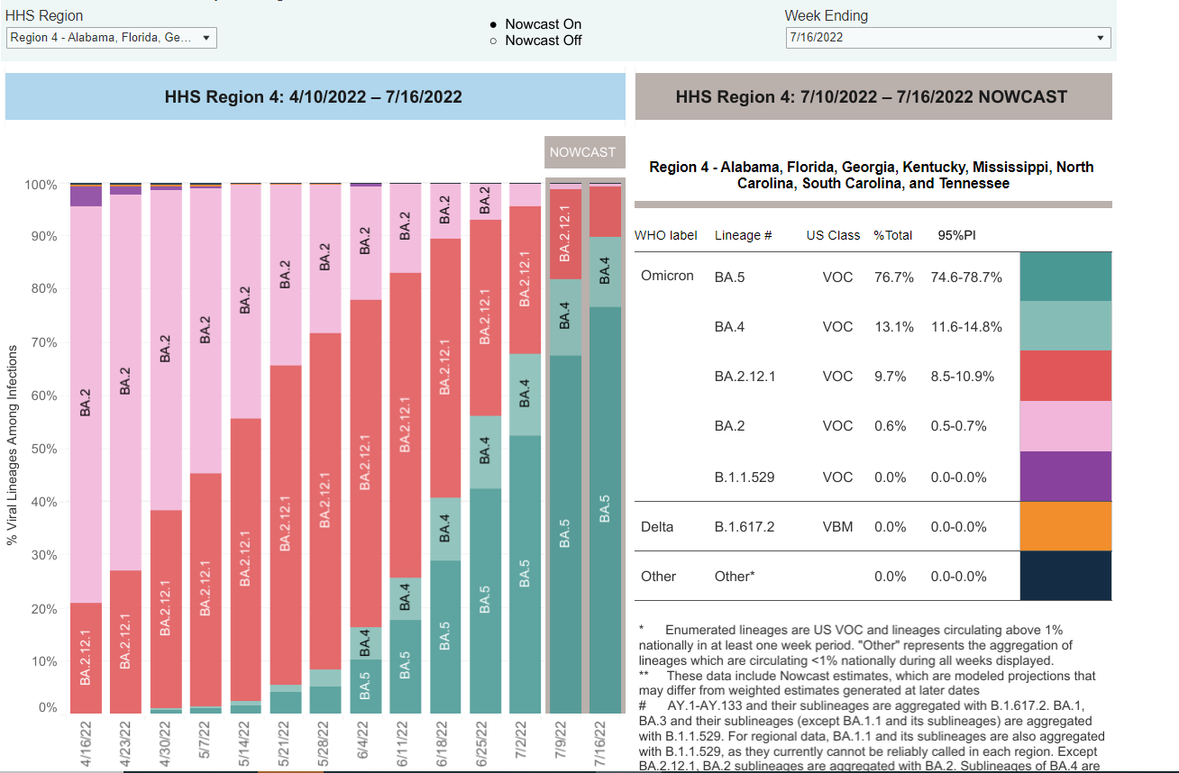
Omicron BA.5 is responsible for this latest surge
Notes:
https://covid.cdc.gov/covid-data-tracker/#variant-proportions

Slide 15
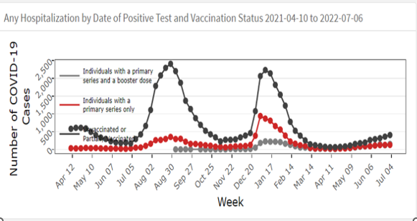
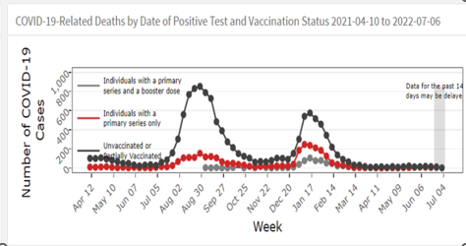
Vaccinations and Boosters are critical in reducing hospitalizations and deaths

Slide 16
COVID-19 TESTING & VACCINATIONS

Slide 17
COVID-19 Free PCR Drive-Through Testing Continues
CDPH/MAKO Labs
Douglas Public Health Center 6770 Selman Dr. Douglasville GA 30134
Monday-Thursday 8am - 3pm; Sat 9am - 12pm
Pre-registration is required. Mako Testing
CDPH/MAKO Labs
Riverside Epicenter, 135 Riverside Parkway, Austell, GA, 30168
Monday – Friday 8am – 3pm
Pre-registration is required. Mako Testing
CDPH/Wellstar/LTS
Wellstar East Cobb Health Park, 3747 Roswell Rd., Marietta, GA 30062
Monday-Friday: 9:00am - 4:00pm
Saturday and Sunday: 10:00am - 2:00pm
Pre-registration is encouraged, but not required. Visit: https://honumg.info/LTSGA004
https://www.cobbanddouglaspublichealth.com/services/epidemiology-infectious-disease/covid-testing/

Slide 18
Free Rapid Antigen Home Test Kits
Visit the Douglas, Marietta, Acworth-Kennesaw, and Smyrna Public Health Centers for your free test kit.
Visit the Acworth-Kennesaw, Smyrna or Douglas Public Health Centers from 8:00am -5:00pm Mon-Fri. Visit the Marietta Public Health Center Pharmacy, Building A, Monday-Friday 8:00am - 11:00am/12noon- 5:00pm or
The kits are free and insurance is not collected.
There is a limit of one kit per person, while supplies last.
Also, every home in the U.S. is eligible to order eight (8) FREE at-⁠home rapid antigen COVID-⁠19 test kits. Orders ship free in 7-12 days. Visit: www.covidtests.gov

Slide 19
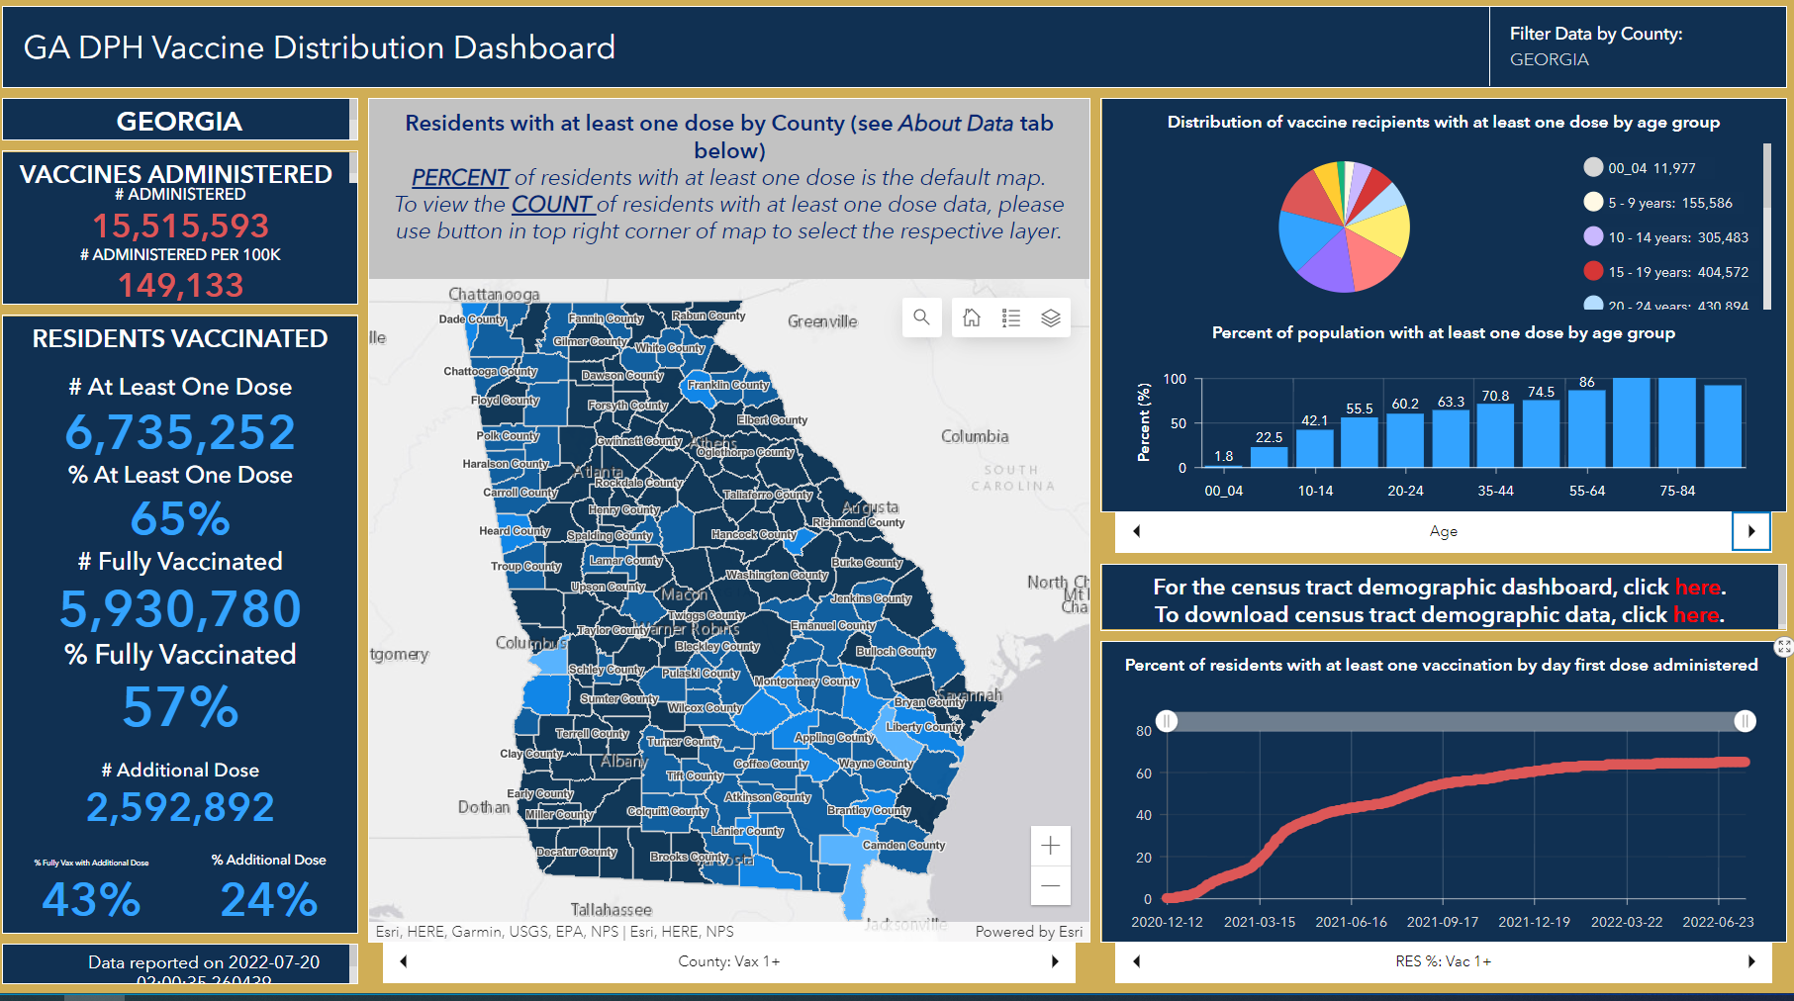
In the U.S., 83.4% of the population (5 years+) received at least 1 dose.
COVID-19 Vaccinations in GA
https://experience.arcgis.com/experience/3d8eea39f5c1443db1743a4cb8948a9c
Notes:
Link to sources:
https://experience.arcgis.com/experience/3d8eea39f5c1443db1743a4cb8948a9c
https://covid.cdc.gov/covid-data-tracker/#vaccinations_vacc-total-admin-rate-total

Slide 20
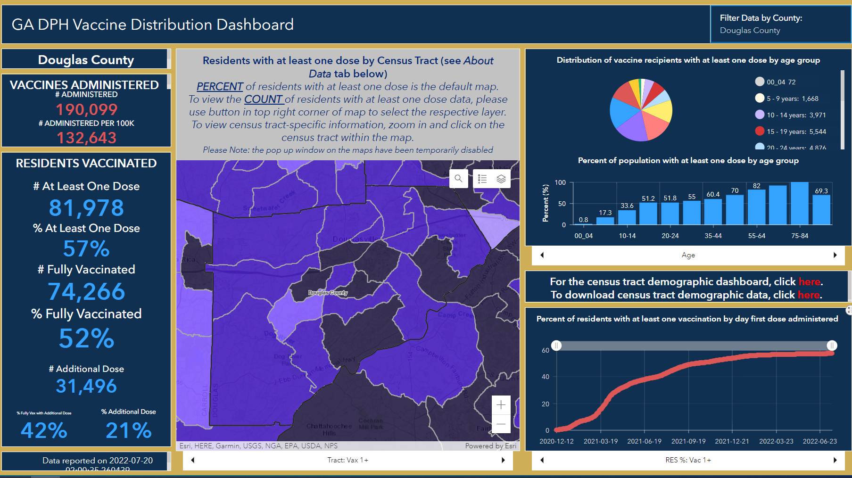
COVID-19 Vaccinations in Douglas County

Slide 21
The CDC’s COVID-19 vaccination recommendations have expanded to ensure protection.
Everyone 6 months and older is eligible to get a free COVID-19 vaccination
CDC now recommends booster shots for those aged 5 and older at least 5 months after primary series.
https://www.cdc.gov/coronavirus/2019-ncov/vaccines/stay-up-to-date.html
https://www.cdc.gov/coronavirus/2019-ncov/vaccines/booster-shot.html#when-you-can-get-booster

Slide 22
Follow basic prevention recommendations:
Stay current with recommended COVID-19 vaccines and boosters
Wear a well-fitting mask regardless of vaccination status when indoors in public
Maintain 6-feet of distance with those outside your home when you are indoors, when possible
Wash your hands often and use hand sanitizer if soap and water are not readily available. Regularly clean high touch areas.
Avoid poorly ventilated spaces and large indoor crowds.
Get tested if you are exposed or have symptoms
Follow CDC recommendations for isolation and quarantine if you are exposed to COVID-19 or have symptoms of COVID-19. The CDC Q&I Calculator is an easy tool to determine next steps. https://www.cdc.gov/coronavirus/2019-ncov/your-health/quarantine-isolation.html#

Slide 23
Questions & Comments?
Visit us online at:
www.CobbandDouglasPublicHealth.org

