Slide 1
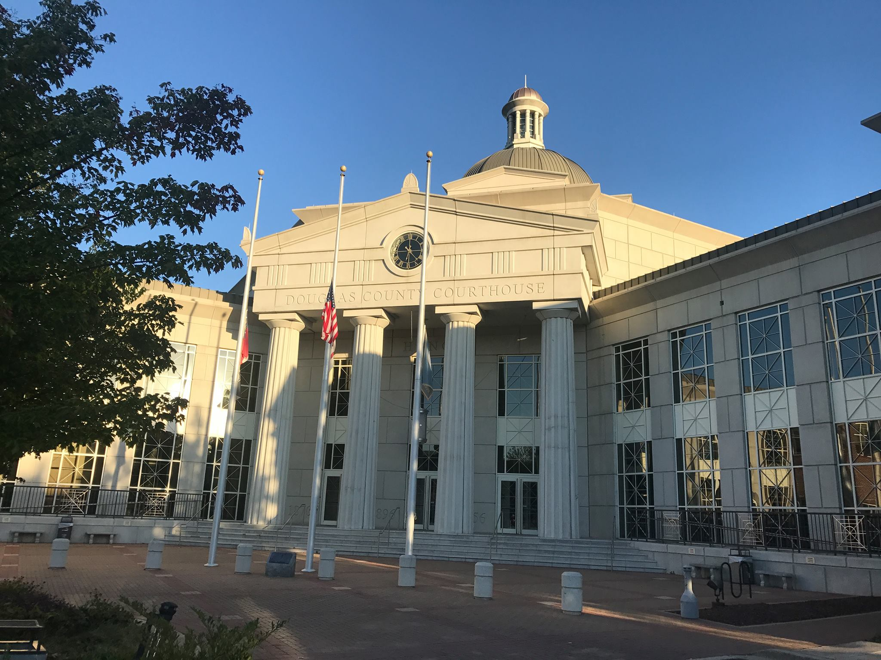

Douglas County, Georgia
Commission Meeting
November 2022
Presentation of Audit Results
December 31, 2021
Notes:
Type your notes

Slide 2

Agenda
Douglas County, Georgia
  Engagement Team
  Overview of:
    Audit Opinion
    Financial Statements and Footnotes
    Compliance Report
    Audit Scopes and Procedures
  Required Communications
  Financial Trends
  Accounting Recommendations, and Related Matters
  Answer Questions
Auditor’s Discussion & Analysis (AD&A)
December 31, 2021
Going Further.

Slide 3
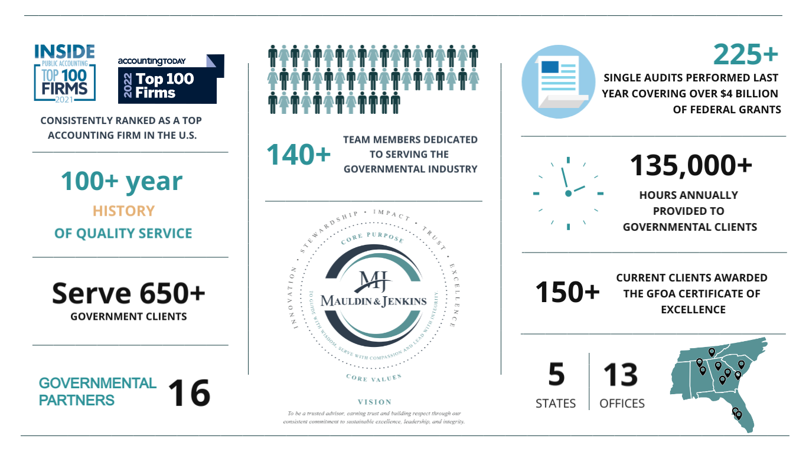
Engagement Team
Douglas County, Georgia
    Engagement Team Leaders
    Meredith Lipson, Engagement Partner | James Bence, Quality Review Partner | Holly Dugas, Engagement Manager
Auditor’s Discussion & Analysis (AD&A)
December 31, 2021
Going Further.

Slide 4
Audit Opinion
Douglas County, Georgia
  Our Responsibility Under Auditing Standards Generally Accepted in the United States of America (GAAS)
    We considered the internal control structure for the purpose of expressing our opinion on Douglas County, Georgia’s (“County”) basic financial statements and not for the purpose of providing an opinion on the effectiveness of internal controls.
    Our audit was performed in accordance with GAAS and Government Auditing Standards.
    Our objective is to provide reasonable—not absolute—assurance that the basic financial statements are free of material misstatement.
    The basic financial statements are the responsibility of the County’s management.
  Report on Basic Financial Statements
    Unmodified (“clean”) opinion on basic financial statements.
    Presented fairly in accordance with accounting principles generally accepted in the United States of America.
    Our responsibility does not extend beyond financial information contained in our report.
Auditor’s Discussion & Analysis (AD&A)
December 31, 2021
Going Further.

Slide 5
Compliance Report and Audit Scopes & Procedures
Douglas County, Georgia
  Compliance Report
    The financial report package contains a report on our tests of the County’s internal controls and compliance with laws, regulations, etc. The report is not intended to provide an opinion on internal controls and compliance with applicable rules and regulations.
    This report and the procedures performed are required by Government Auditing Standards.
  Audit Scopes and Procedures (Governmental Audit Programs Utilized in All Areas)
    Confirmed cash, debt and other elements.
    Vouched substantiated additions of capital assets, balances of construction in progress, and vouched significant retainage payable.
    Performed a search for unrecorded liabilities via review of unpaid vouchers and subsequent disbursements.
Auditor’s Discussion & Analysis (AD&A)
December 31, 2021
Going Further.

Slide 6
Required Communications
Douglas County, Georgia
  Significant Accounting Policies
    Management is responsible for the selection and use of appropriate accounting policies.
    The significant accounting policies used by the County are described in Note 1 to the respective basic financial statements.
    No new Governmental Accounting Standards Board (GASB) Statements were implemented in 2021.
    The policies used by the County are in accordance with generally accepted accounting principles.
    In considering the qualitative aspects of its policies, the County is not involved in any controversial or emerging issues for which guidance is not available.
  Management Judgment/Accounting Estimates
    Accounting estimates are an integral part of the financial statements prepared by management and are based on management’s knowledge and experience about past and current events and assumptions about future events.
    The County uses various estimates as part of its financial reporting process – including actuarial assumptions.
Auditor’s Discussion & Analysis (AD&A)
December 31, 2021
Going Further.

Slide 7
Required Communications (Continued)
Douglas County, Georgia
  Relationship with Management
    We received full cooperation from the County’s management and staff.
    There were no disagreements with management on accounting issues or financial reporting matters.
  Management Representation
    We requested, and received, written representations from management relating to the accuracy of information included in the financial statements and the completeness and accuracy of various information requested by us.
  Consultation with Other Accountants
    To the best of our knowledge, management has not consulted with, or obtained opinions from, other independent accountants during the year, nor did we face any issues requiring outside consultation.
  Significant Issues Discussed with Management
    There were no significant issues discussed with management related to business conditions, plans, or strategies that may have affected the risk of material misstatement of the financial statements.
Auditor’s Discussion & Analysis (AD&A)
December 31, 2021
Going Further.

Slide 8
Required Communications (Continued)
Douglas County, Georgia
  Audit Adjustments
    There were no unrecorded or passed audit adjustments.
  Financial Statement Disclosures
    The footnote disclosures to the financial statements are also an integral part of the financial statements and the process used by management to accumulate the information included in the disclosures was the same process used in accumulating the statements. The overall neutrality, consistency, and clarity of the disclosures was considered as part of our audit.
  Information in Documents Containing Audited Financial Statements
    Our responsibility for other information in documents containing the County’s basic financial statements and our report thereon does not extend beyond the information identified in our report. If you intend to publish or otherwise reproduce the financial statements and make reference to our firm, we must be provided with printers’ proof for our review and approval before printing. You must also provide us with a copy of the final reproduced material for our approval before it is distributed.
  Auditor Independence
    In accordance with AICPA professional standards, M&J is independent with regard to County and their financial reporting process.
Auditor’s Discussion & Analysis (AD&A)
June 30, 2021
Going Further.

Slide 9
Trend Analysis – General Fund Revenues
Douglas County, Georgia
Auditor’s Discussion & Analysis (AD&A)
December 31, 2021
Going Further.

Slide 10
Trend Analysis – General Fund Revenues (continued)
Douglas County, Georgia
Auditor’s Discussion & Analysis (AD&A)
December 31, 2021
Going Further.

Slide 11
Trend Analysis – General Fund Expenditures
Douglas County, Georgia
Auditor’s Discussion & Analysis (AD&A)
December 31, 2021
Going Further.

Slide 12
General Fund Expenditures vs. Fund Balance
Douglas County, Georgia
Auditor’s Discussion & Analysis (AD&A)
December 31, 2021
Going Further.

Slide 13
General Fund – Change in Fund Balance
Douglas County, Georgia
Auditor’s Discussion & Analysis (AD&A)
December 31, 2021
Going Further.

Slide 14
Accounting Recommendations and Related Matters
Douglas County, Georgia
Audit Findings
Audit Finding 2021-001 – Decentralized Accounting & Financial Reporting
During our audit of the offices of the County’s elected officials, we noted that none of the offices have implemented a general ledger accounting system for the custodial and special revenue funds, several of which involve the use of federal grant funds. Information therefore had to be compiled for the annual audit. Additionally, due to the limited number of individuals in these offices, a complete separation of duties does not exist over the accounting functions and, in several cases, one individual has access to numerous stages of the cash receipting, cash disbursing, and reconciliation processes. We strongly recommend these offices implement general leger accounting systems for their respective custodial and special revenue funds, or work with the Finance department to maintain a general ledger with information provided by the offices of the elected officials. We also recommend County management review the processes in each of these offices to determine where duties can be separated or compensating controls put in place.
Auditor’s Discussion & Analysis (AD&A)
December 31, 2021
Going Further.

Slide 15
Accounting Recommendations and Related Matters
Douglas County, Georgia
Audit Findings (continued)
Audit Finding 2021-002 – Year-End Financial Close and Reporting Controls
During our audit, we noted that certain internal controls were not in place to ensure proper reporting of various account balances in the County’s year-end financial statements. Controls were not able to detect a number of adjustments needed to account balances to be properly stated. Over fifty (50) adjusting journal entries totaling in excess of $30M were required to be made during the audit process. We recommend the County carefully review its year-end close out processes to ensure accounts are adjusted as needed prior to the annual audit.
Accounting Recommendations
Capital Assets and Construction in Progress
During our testing of capital assets and construction in progress, it was noted that there was no centralized system of tracking all of the County’s CIP. Multiple personnel and departments track different projects separately, rather than all projects being centrally tracked. Further, the schedules provided did not contain the necessary detail to facilitate testing such as invoices or individual costs incurred. We recommend that the County designate one or more individuals to be responsible for maintaining an organized, complete, and centralized construction in progress schedule on a continuous basis for all departments. On a monthly basis, a formal reconciliation of the schedule to balances in the County’s accounting records should be submitted and reviewed by the Finance Director.
Auditor’s Discussion & Analysis (AD&A)
December 31, 2021
Going Further.

Slide 16
Accounting Recommendations and Related Matters
Douglas County, Georgia
Accounting Recommendations
ARPA Fund Budget
During our audit of the ARPA Fund, it was noted that expenditures exceeded budget by $2,600,810, as the County budgeted no expenditures for 2021. While the County may have originally planned to have no expenditures of ARPA funds in 2021 when the budget was passed, once it was determined that expenditures would be incurred, an amendment to the budget should have been submitted to the County Commission for approval. We recommend the County closely monitor budget to actual activity and when necessary, amend the budget to reflect changes in conditions.
Outstanding Checks
During our audit of cash, we noted several outstanding checks on bank reconciliations in the Magistrate Court and State Court that have been outstanding in excess of five (5) years. According to the Escheat Laws of Georgia, checks outstanding in excess of five (5) years should be remitted to the State. We recommend the County review all bank reconciliations and related outstanding check listings on a regular basis for checks that have been outstanding for more than five (5) years and remit these checks to the State in accordance with the Escheat laws.
Implementation of GASB 87
For the year ended December 31, 2022 the County will be required to implement GASB Statement No. 87, Leases. We recommend County management review the requirements of GASB 87 and begin compiling the information now so that it is prepared to implement the necessary changes for next year’s audit.
Auditor’s Discussion & Analysis (AD&A)
December 31, 2021
Going Further.

Slide 17
Accounting Recommendations and Related Matters
Douglas County, Georgia
Accounting Recommendations
Grants Accounting
During our audit of federal and state grants, we noted that the County does not have a centralized process for tracking grants and ensuring proper accounting for revenues and expenditures, as well as adherence to reporting and compliance requirements. Grants are received for a variety of purposes, each with their own unique reporting and compliance requirements. To ensure all grants are appropriately accounted for, properly reported on the Schedule of Expenditures of Federal Awards, and in compliance with all grant requirements, we recommend the County assign the responsibility of grants management to a specific individual.
Timeliness of Audit Process
The past year has been challenging for the County’s Finance department, as a full-time, on-site Finance Director was not in place. This situation led to significant delays in completion of the 2021 annual audit. Information needed and responses to inquiries were not received in a timely manner. Additionally, it was often difficult for auditors to determine which County staff were responsible for addressing items needed and/or questions. We recognize that the Finance Director position has now been filled, and we recommend County management work with the Finance department to be better prepared for the 2022 audit.
Auditor’s Discussion & Analysis (AD&A)
December 31, 2021
Going Further.

Slide 18
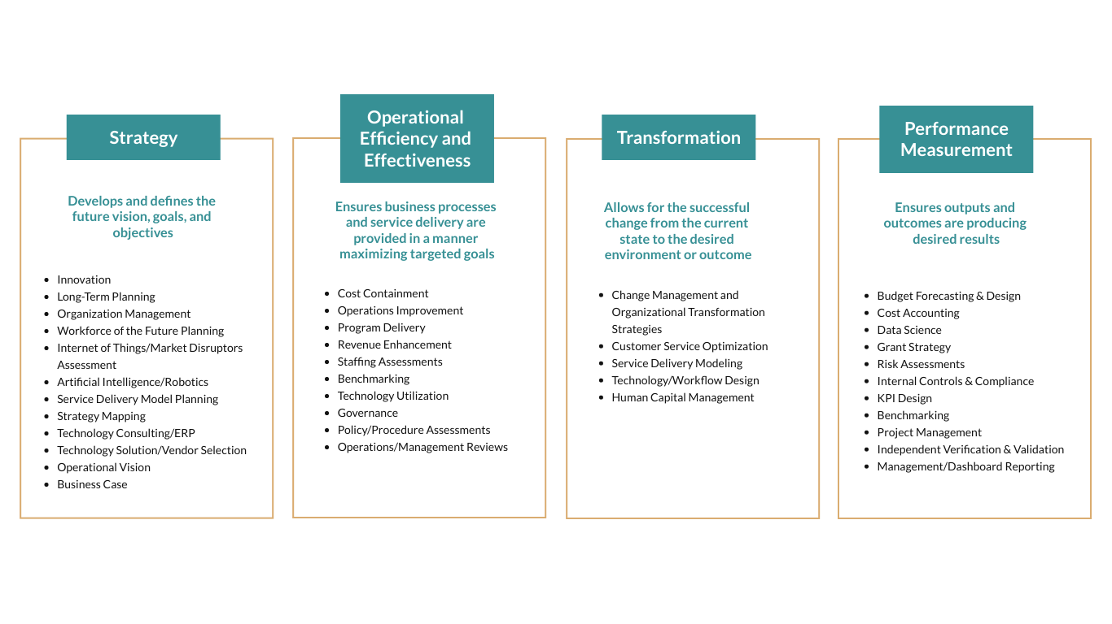
Governmental Advisory Services
Douglas County, Georgia
Core Offerings
Auditor’s Discussion & Analysis (AD&A)
December 31, 2021
Going Further.

Slide 19
New Accounting Pronouncements
Douglas County, Georgia
  New GASB Pronouncements for Future Years
    Statement No. 87, Leases was issued in June 2017 and is effective for the first reporting period beginning after December 15, 2019. However, in light of the COVID-19 Pandemic, in May 2020 the GASB issued Statement No. 95 (Postponement of the Effective Dates of Certain Authoritative Guidance) which changed the effective date of Statement No. 87 to fiscal years beginning after June 15, 2021.
    Statement No. 91, Conduit Debt Obligations was issued in May 2019 and is effective for the first reporting period beginning after December 15, 2020, meaning for those with year ends of December 31, 2021 and beyond. However, in light of the COVID-19 Pandemic, in May 2020 the GASB issued Statement No. 95 (Postponement of the Effective Dates of Certain Authoritative Guidance) which changed the effective date of Statement No. 91 to reporting periods beginning after December 15, 2021.
Auditor’s Discussion & Analysis (AD&A)
December 31, 2021
Going Further.

Slide 20
New Accounting Pronouncements (Continued)
Douglas County, Georgia
  New GASB Pronouncements for Future Years (Continued)
    Statement No. 92, Omnibus 2020 was issued in January 2020 and because it is an omnibus standard, contains several different effective dates as follows (as amended by Statement No. 95 issued in May 2020).
    For fiscal years beginning after June 15, 2021 relative to the requirements related to intra-entity transfers of assets and those related to the applicability of Statements No. 73 and 74.
    For reporting periods beginning after June 15, 2021 relative to the requirements related to application of Statement No. 84 to postemployment benefit arrangements and those related to nonrecurring fair value measurements of assets or liabilities.
    For government acquisitions occurring in reporting periods beginning after June 15, 2021. The requirements related to the measurement of liabilities (and assets, if any) associated with AROs in a government acquisition.
    Other items addressed by this omnibus statement (requirements related to Statement No. 87 and Implementation Guide 2019-3, reinsurance recoveries, and terminology used to refer to derivative instruments) were effective upon issuance.
    Statement No. 93, Replacement of Interbank Offered Rates was issued in March 2020 and contains two (2) different effective dates. The removal of LIBOR as an appropriate benchmark interest rate is effective for reporting periods ending after December 31, 2021. All other requirements of this statement are effective for reporting periods beginning after June 15, 2020.
    Statement No. 94, Public-Private and Public-Public Partnerships and Availability Payment Arrangements was issued in March 2020 and is effective for fiscal years beginning after June 15, 2022 which means year ends of June 30, 2023 and following.
Auditor’s Discussion & Analysis (AD&A)
December 31, 2021
Going Further.

Slide 21
New Accounting Pronouncements (Continued)
Douglas County, Georgia
  New GASB Pronouncements for Future Years (Continued)
      Statement No. 96, Subscription-Based Information Technology Arrangements was issued in May 2020 and is effective for fiscal years beginning after June 15, 2022 which means year ends of June 30, 2023 and following.
      Statement No. 97, Certain Component Unit Criteria, and Accounting and Financial Reporting for Internal Revenue Code Section 457 Deferred Compensation Plans was issued in June 2020 and is effective for fiscal years beginning after June 15, 2021 (year ends of June 30, 2022 and following).
Auditor’s Discussion & Analysis (AD&A)
December 31, 2021
Going Further.

Slide 22
New Accounting Pronouncements (Continued)
Douglas County, Georgia
  New GASB Pronouncements for Future Years (Continued)
      Other Pending or Current GASB Projects (Continued):
  Re-Examination of the Financial Reporting Model. GASB has added this project to its technical agenda to make improvements to the existing financial reporting model (established via GASB issued Statement No. 34). Improvements are meant to enhance the effectiveness of the model in providing information for decision-making and assessing a government’s accountability. GASB anticipates a final standard expected in early 2022.
  Conceptual Framework is a constant matter being looked at by GASB. Current measurement focus statements (for governmental funds) to change to near-term financial resources measurement. May dictate a period (such as 60 days) for revenue and expenditure recognition. May expense things such as supplies and prepaid assets at acquisition. Will look into which balances (at all statement levels) are measured at acquisition and which need to be re-measured at year-end. Final standard is expected in 2022.
  Revenue and Expense Recognition is another long-term project where the GASB is working to develop a comprehensive application model for recognition of revenues and expenses from non-exchange, exchange, and exchange-like transactions. The final standard is expected in 2023.
  Compensated Absences is technical topic being examined by the GASB currently due to significant changes in benefits offered by governmental employers. Current GAAP does not address certain items such as paid time off (PTO) and there is a wide divergence in practice. A final standard on this topic is expected towards the end of 2021.
  Prior-Period Adjustments, Accounting Changes, and Error Corrections is a technical topic being examined by the GASB due to a wide diversity in practice regarding required presentation on the face of the financial statements, disclosures, etc. A final standard on this topic is expected in early 2022.
Auditor’s Discussion & Analysis (AD&A)
December 31, 2021
Going Further.

Slide 23
Govt. Clients – Free Quarterly Continuing Education
Douglas County, Georgia
  Since March of 2009 – For Over 12 Years !!
      Mauldin & Jenkins provides free quarterly continuing education for all of our governmental clients. Topics are tailored to be of interest to governmental entities. In an effort to accommodate our entire governmental client base, we offer the sessions several times per quarter at a variety of client provided locations resulting in greater networking and knowledge sharing among our governmental clients. We normally see approximately 180 people per quarter. Examples of subjects addressed in the past few quarters include:
        .
Accounting for Debt Issuances
Achieving Excellence in Financial Reporting
Best Budgeting Practices, Policies and Processes
Budget Preparation
ACFR Preparation (two (2) day hands-on course)
Capital Asset Accounting Processes and Controls
Collateralization of Deposits and Investments
Component Units
Cybersecurity Risk Management
Evaluating Financial and Non-Financial Health of a Govt.
Financial Report Card – Where Does Your Govt. Stand?
Financial Reporting Model Improvements
GASB Nos. 74 & 75, OPEB Standards
GASB No. 77, Tax Abatement Disclosures
GASB No. 84, Fiduciary Activities
GASB Projects & Updates (ongoing & several sessions
Human Capital Management
Grant Accounting Processes and Controls
Internal Controls Over Accounts Payable, Payroll and
Cash Disbursements
Internal Controls Over Receivables & the Revenue Cycle
IRS Issues, Primarily Payroll Matters
Legal Considerations for Debt Issuances & Disclosures
Policies and Procedures Manuals
Segregation of Duties
Single Audits for Auditees
Special Purpose Local Option Sales Tax (SPLOST)
Accounting, Reporting & Compliance
Uniform Grant Reporting Requirements and the New
Single Audit
Auditor’s Discussion & Analysis (AD&A)
December 31, 2021
Going Further.

Slide 24
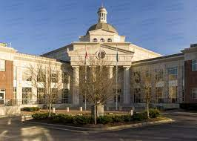
Questions & Comments
Thank You for the Opportunity to Serve
Notes:
Type your notes

